Slide 1







SPECTRUM THUNDER
ATHLETIC AWARDS
BANQUET
2025-2026

Slide 2





GREATER VICTORIA SCHOOL DISTRICT
TERRITORIAL ACKNOWLEDGEMENT
THE GREATER VICTORIA SCHOOL DISTRICT WISHES TO RECOGNIZE AND ACKNOWLEDGE THE ESQUIMALT AND SONGHEES NATIONS, ON WHOSE TRADITIONAL TERRITORIES, WE LIVE, WE LEARN, AND WE DO OUR WORK.

Slide 3

TEAMS
27 DISTINCT TEAMS PARTICIPATING IN LVISSAA & BC SCHOOL SPORTS!
PARTICIPANTS
328 DISTINCT ATHLETES TAKING PART IN ATHLETICS AT SPECTRUM!
111 MULTI-SPORT ATHLETES
5 STUDENT ATHLETES GOING ON TO PLAY COLLEGIATE SPORT!
ATHLETICS YEAR
IN REVIEW
2025-2026
ATTENDED ISLANDS (12)
  CROSS COUNTRY
  JUNIOR GIRLS VOLLEYBALL 9
  JUNIOR GIRLS VOLLEYBALL 10
  SENIOR BOYS VOLLEYBALL
  SWIMMING
  JUNIOR GIRLS BASKETBALL
  SENIOR BOYS BASKETBALL
  WRESTLING
  TRACK & FIELD
  JUNIOR GIRLS SOCCER
  SENIOR GIRLS SOCCER
  JUNIOR BOYS RUGBY
ATTENDED PROVINCIALS (5)
  CROSS COUNTRY
  JUNIOR GIRLS VOLLEYBALL 10
  SWIMMING
  WRESTLING
  TRACK & FIELD

Slide 4


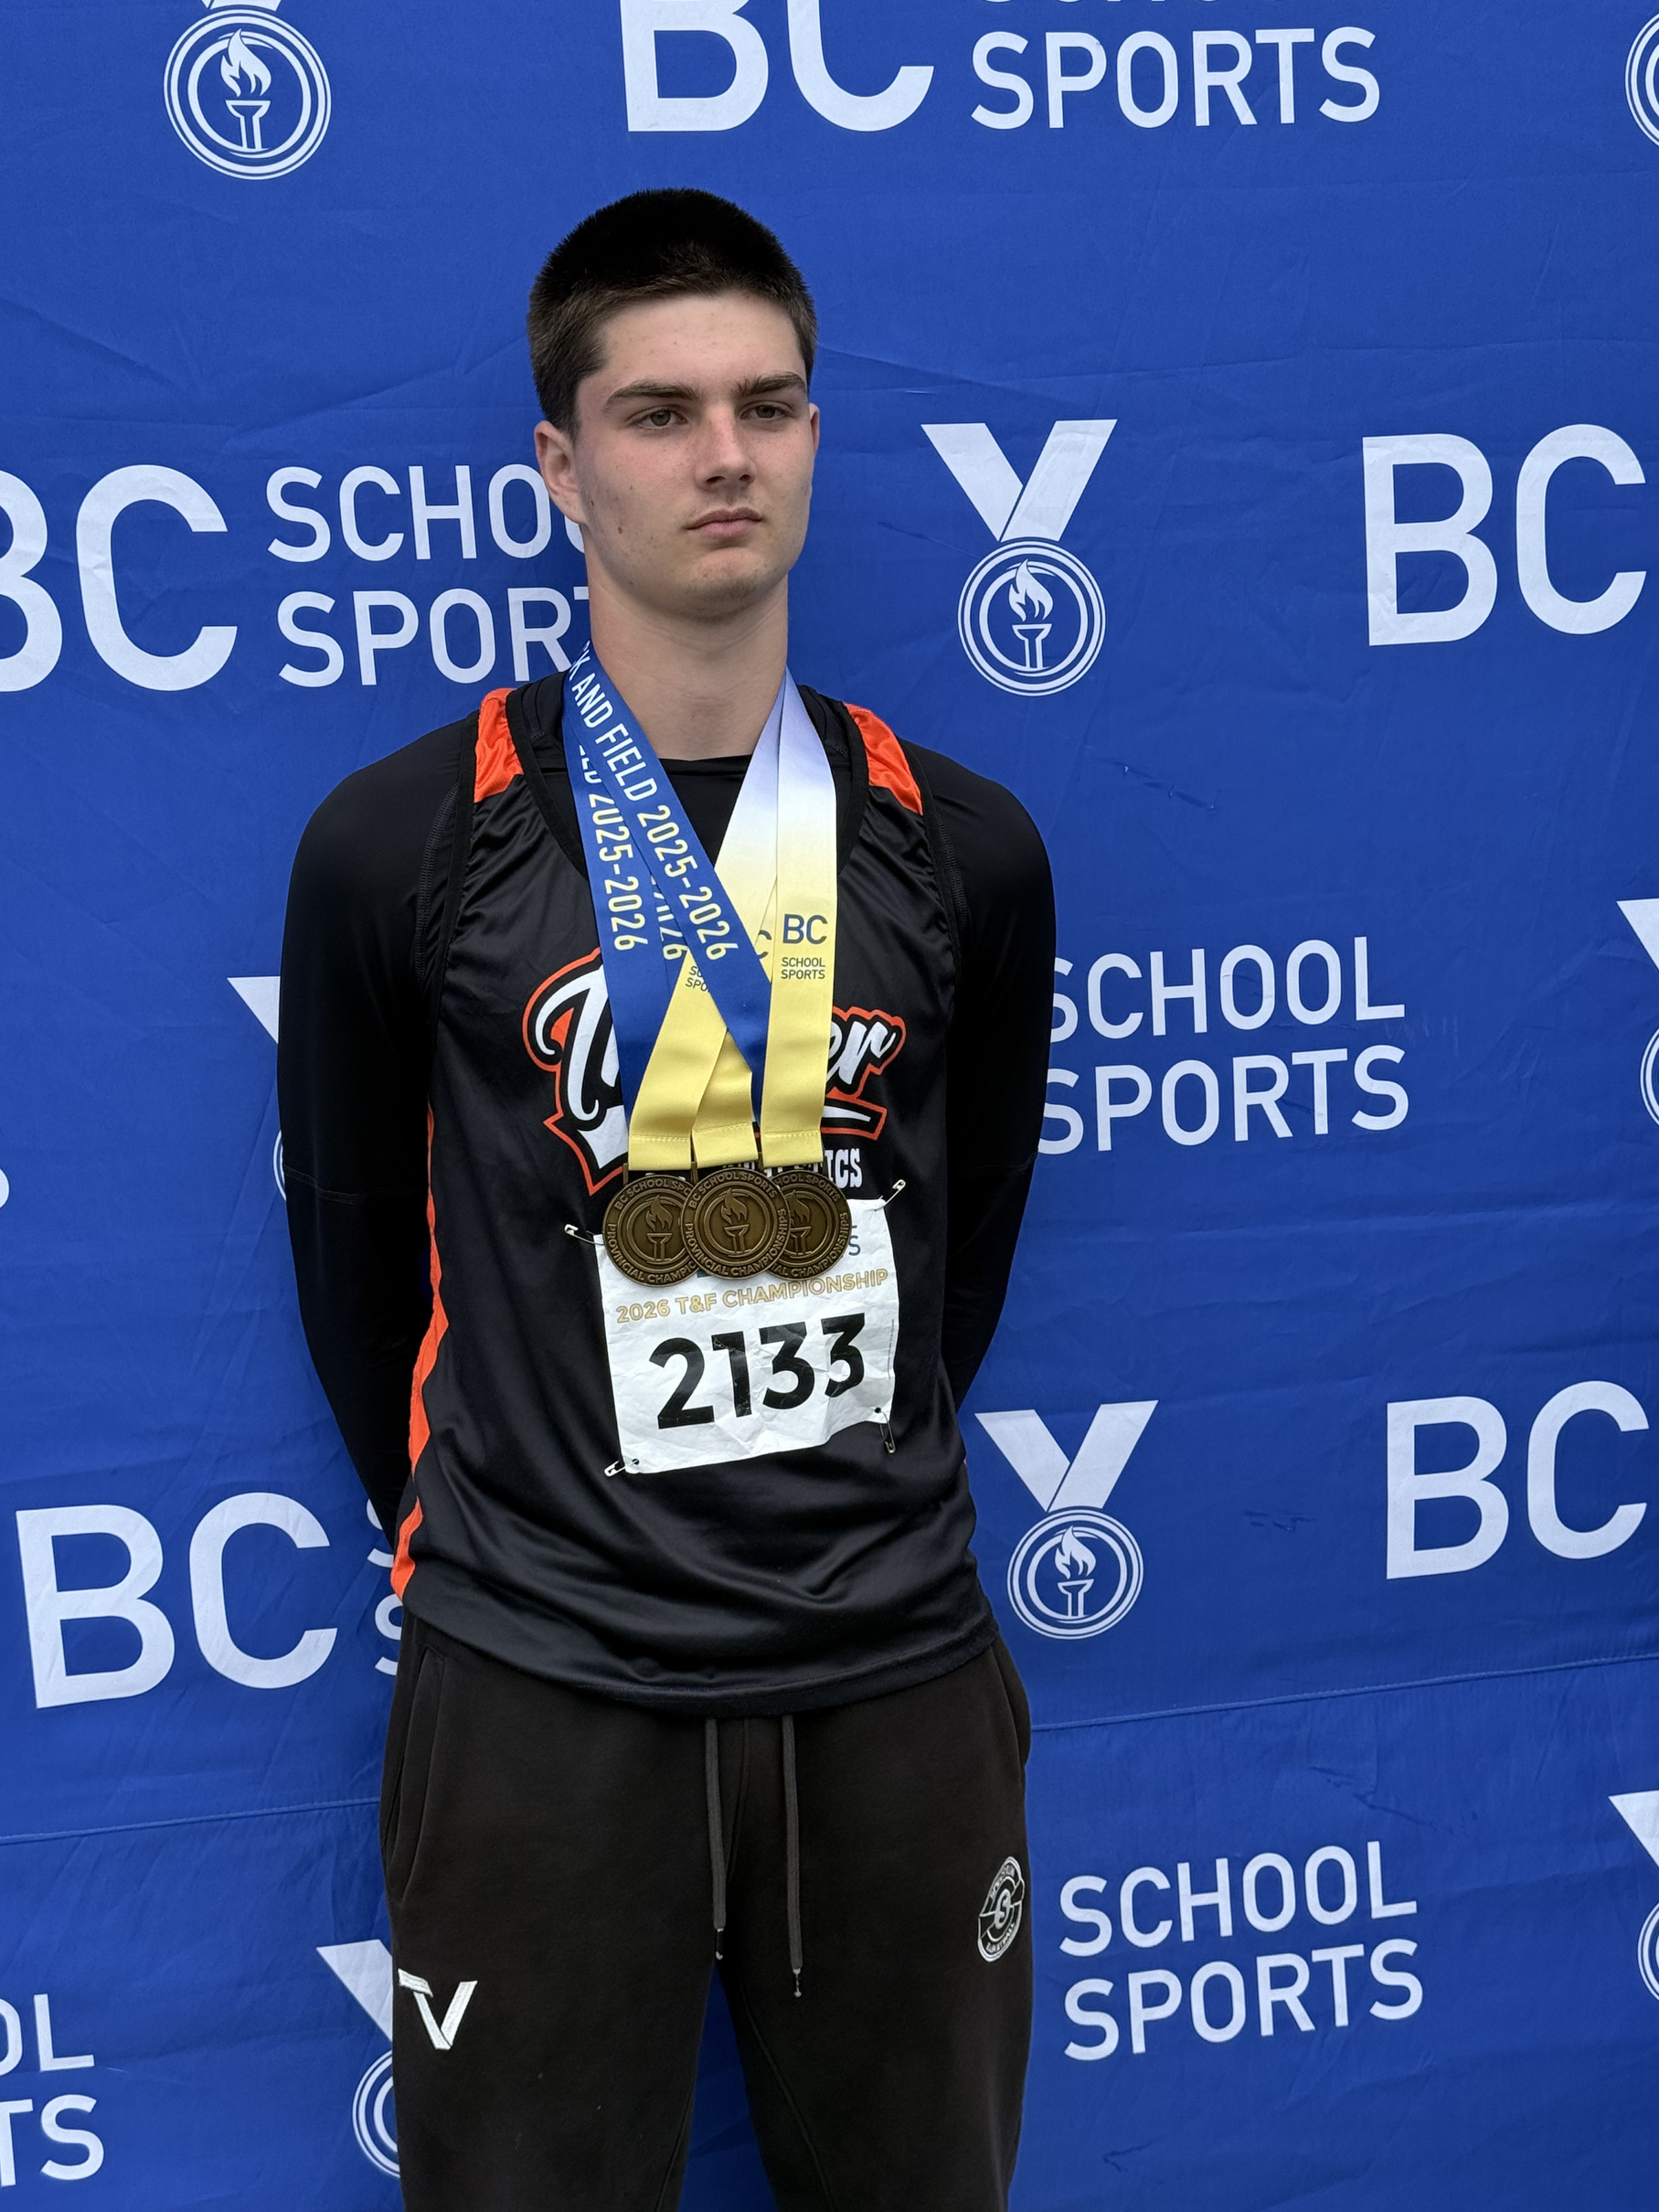

LEVI
SEEL
TRACK & FIELD
PROVINCIAL GOLD MEDAL - JR BOYS JAVELIN
PROVINCIAL GOLD MEDAL - JR BOYS DISCUS
PROVINCIAL GOLD MEDAL - JR BOYS SHOTPUT

Slide 5
COLLEGIATE
SIGNINGS

Slide 6

CAYMAN
REMPEL
WOMEN’S RUGBY
Lander University
(NCR Division 1)

Slide 7

MAPLE
ITO-WARD
WOMEN’S ICE HOCKEY
Northwestern Polytechnic College
(ACAC)

Slide 8

ELIZA
KENT
WOMEN’S ICE HOCKEY
NAIT Ooks
(ACAC)

Slide 9

KATHARINA
CRONKHITE
WOMEN’S SOCCER
University of Toronto
(OUA USport)

Slide 10

CALLIE
TURPIN
WOMEN’S SOCCER
St. Bonaventure University
(NCAA Division 1)

Slide 11

FALL
SPORTS
FOOTBALL
SWIMMING
CROSS COUNTRY
JUNIOR BOYS SOCCER
SENIOR BOYS SOCCER
JUNIOR GIRLS 9/10 REC VOLLEYBALL
JUNIOR GIRLS 9 VOLLEYBALL
JUNIOR GIRLS 10 VOLLEYBALL
SENIOR GIRLS VOLLEYBALL
JUNIOR BOYS VOLLEYBALL
SENIOR BOYS VOLLEYBALL

Slide 12

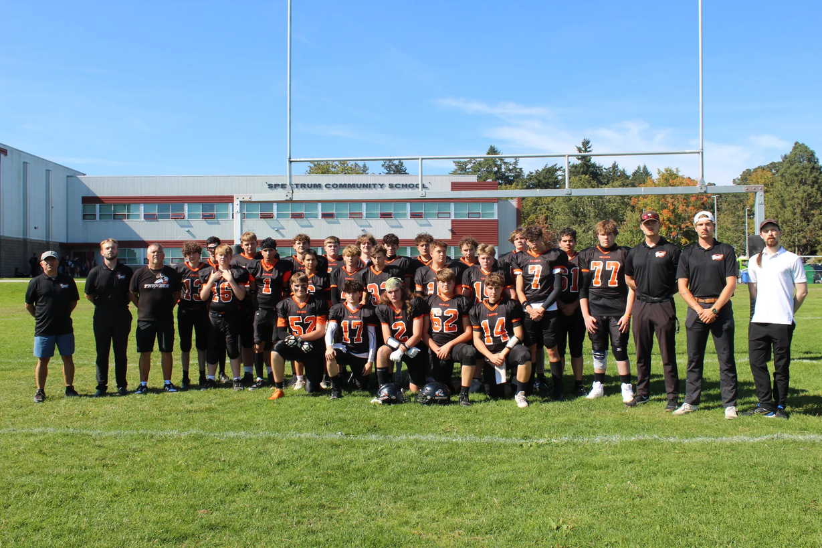

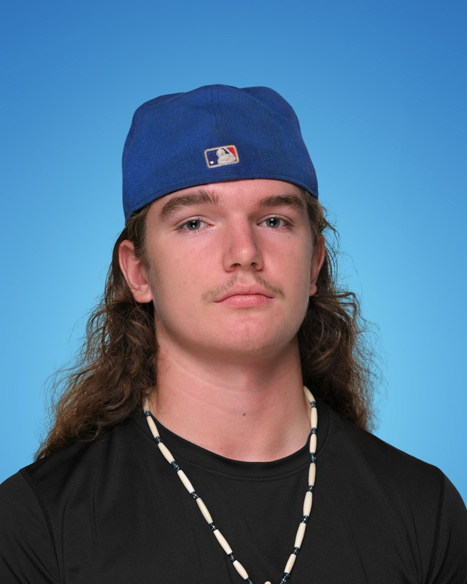
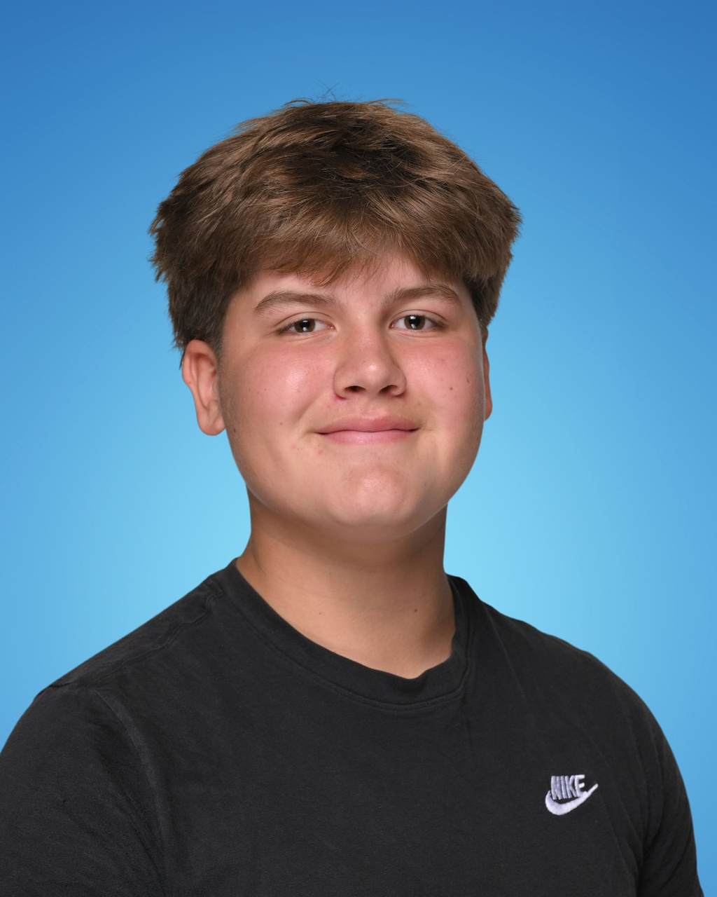
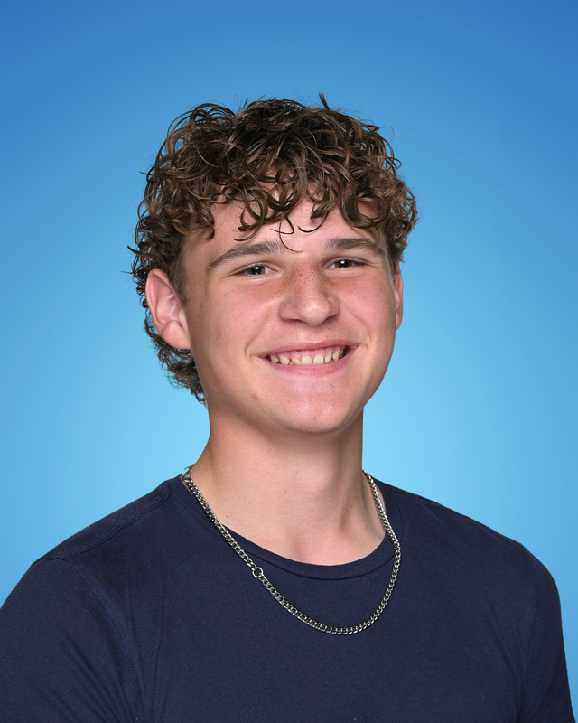
FOOTBALL
VARSITY
TEAM MVPS
VARSITY: HECTOR HALL
JUNIOR VARSITY: JACK RAMSAY & AUSTIN KELLOW
JR. VARSITY
JR. VARSITY

Slide 13
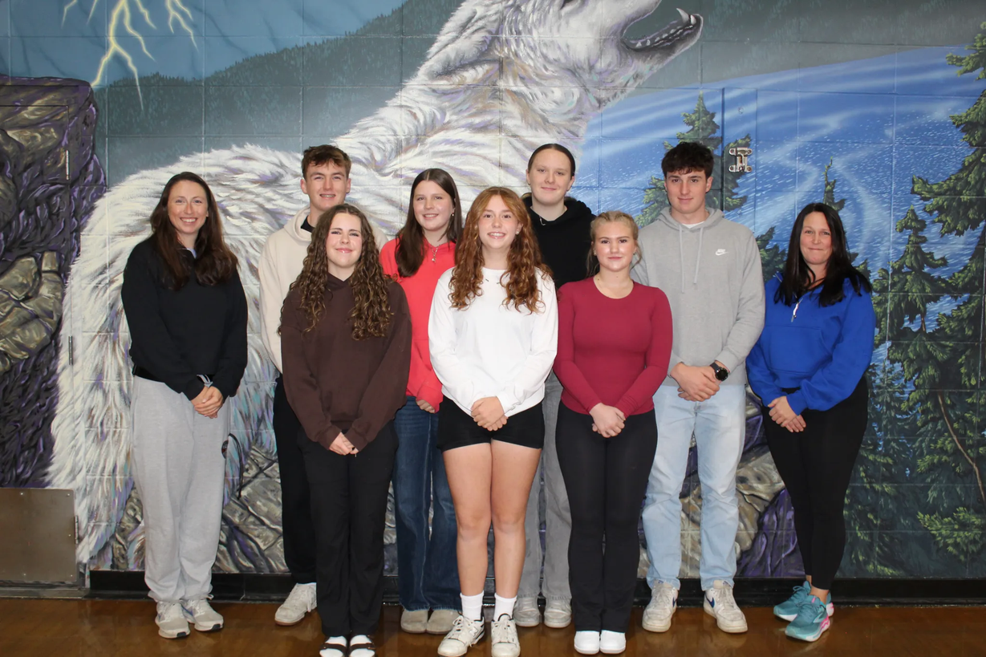
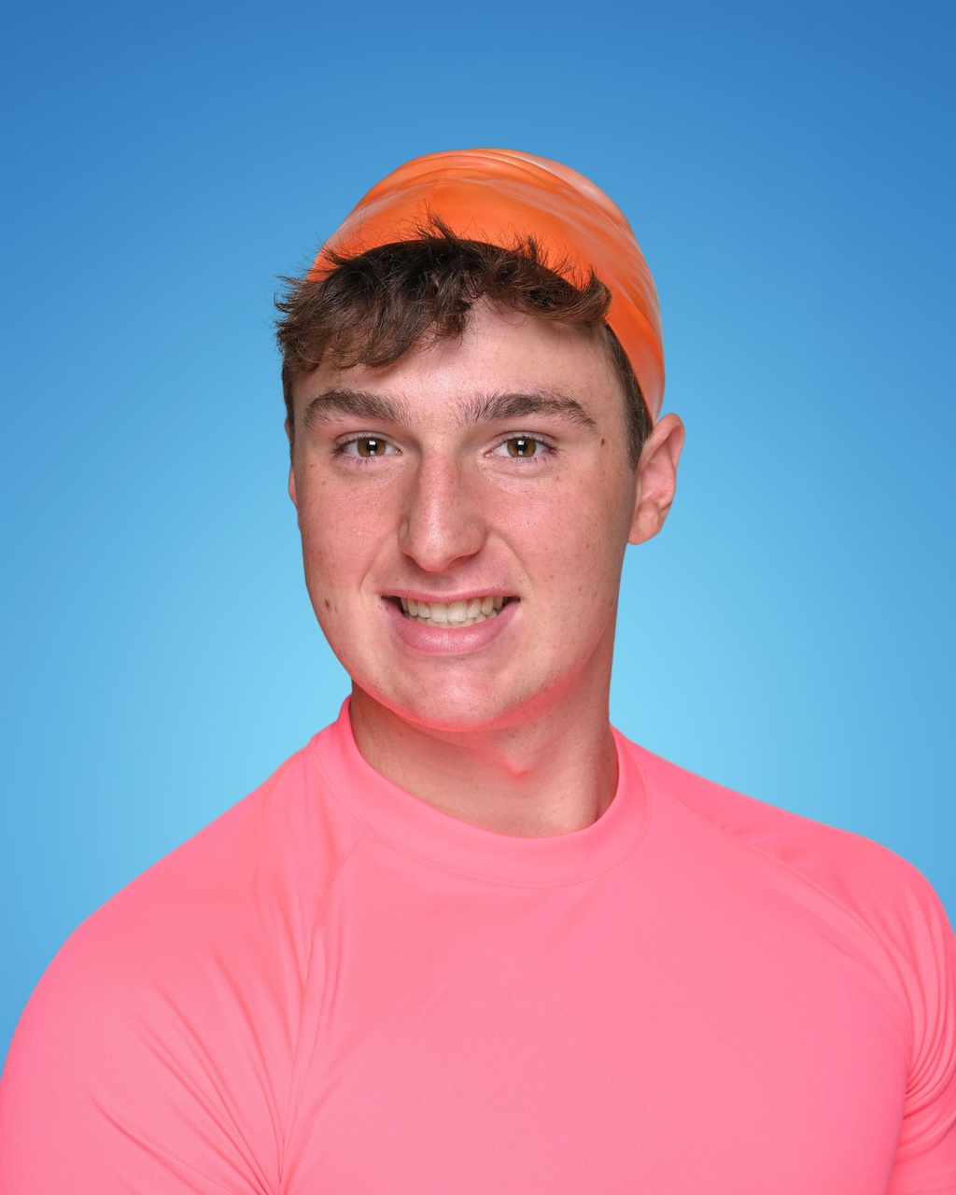
SWIMMING
TEAM MVP -
JULIAN MILLER

Slide 14
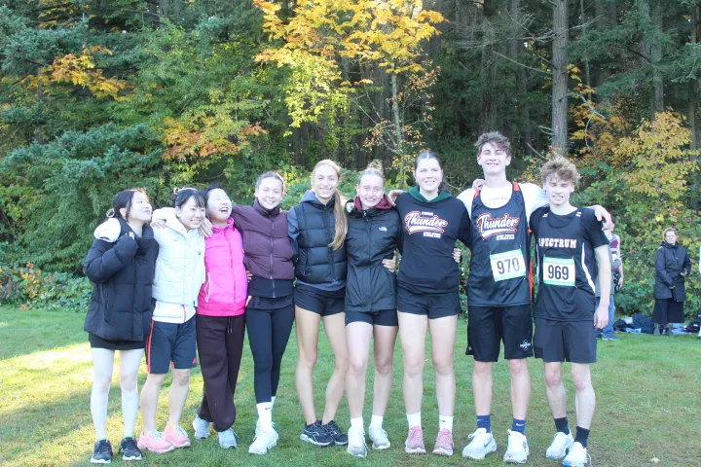
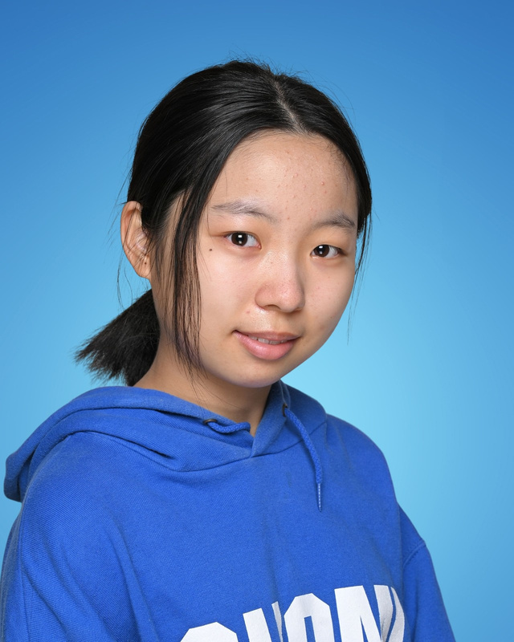
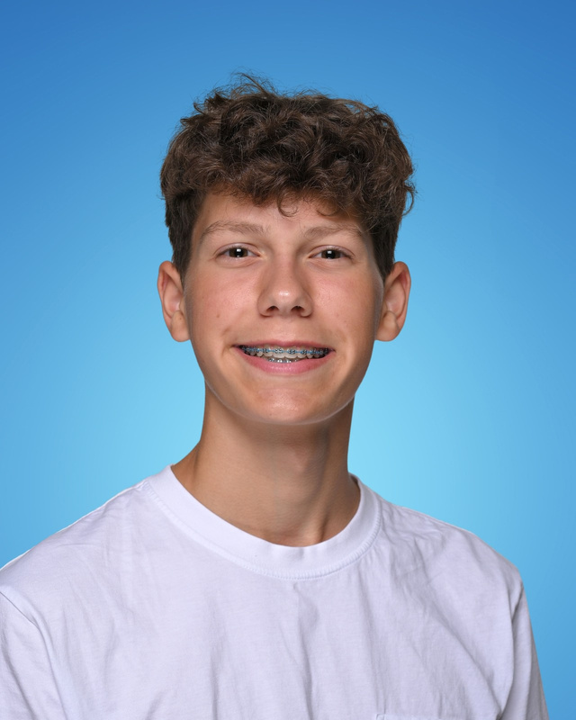
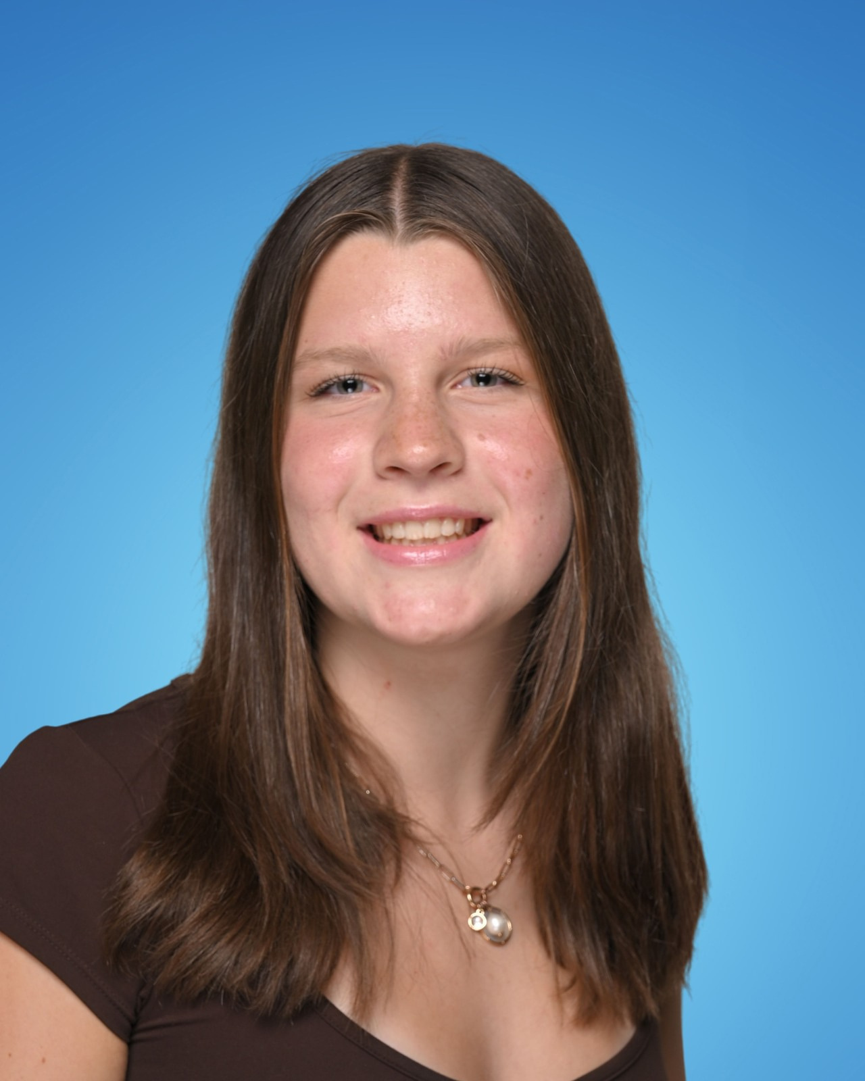
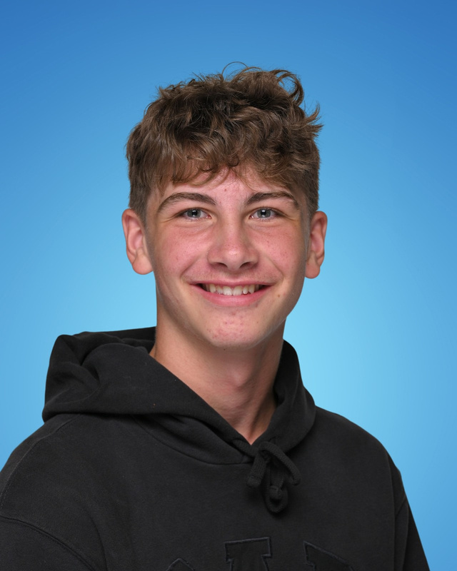
CROSS COUNTRY
JR. GIRL
JR. BOY
TEAM MVPS -
RIMI TSUKIKAWA - COOPER ELLIOTT
ALANNA FELT - LUCAS RUSSELL
SR. GIRL
SR. BOY

Slide 15
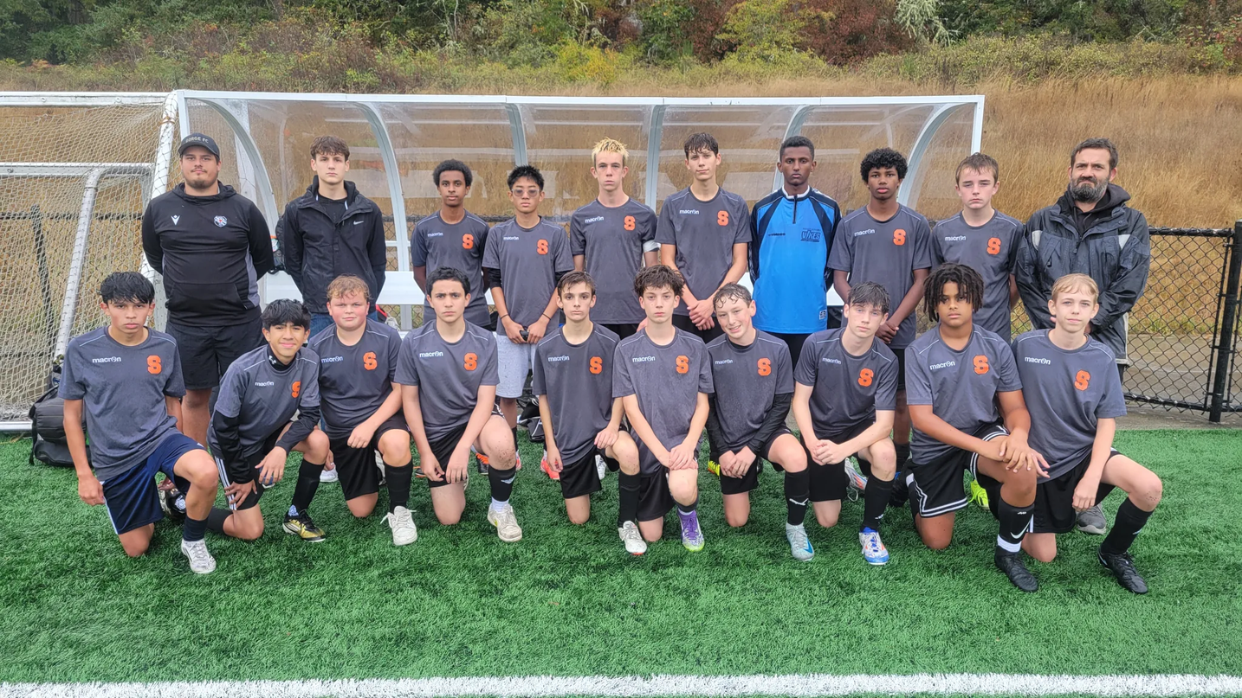
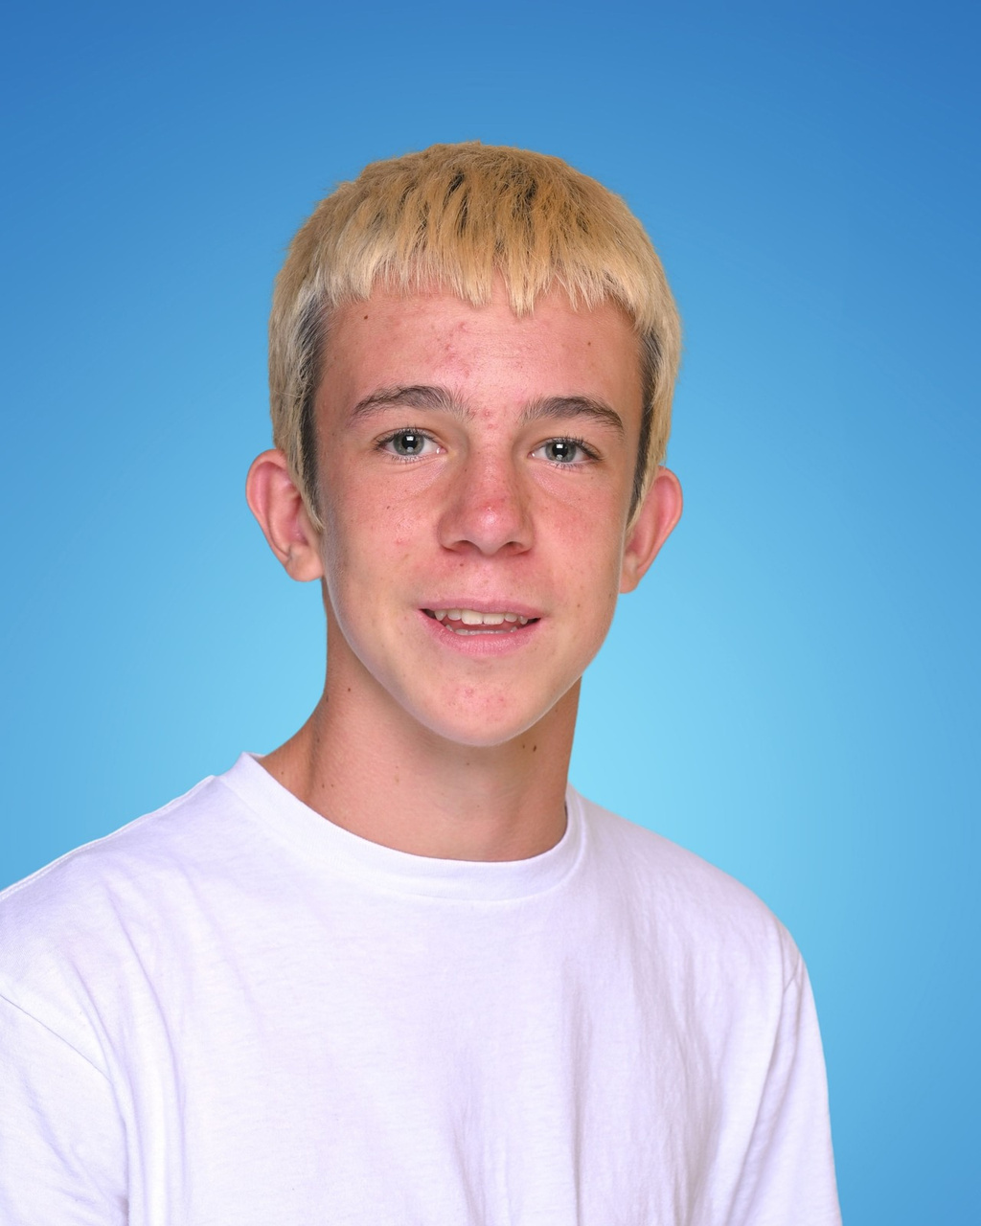
JUNIOR BOYS SOCCER
TEAM MVP -
KESLER BOLTON

Slide 16
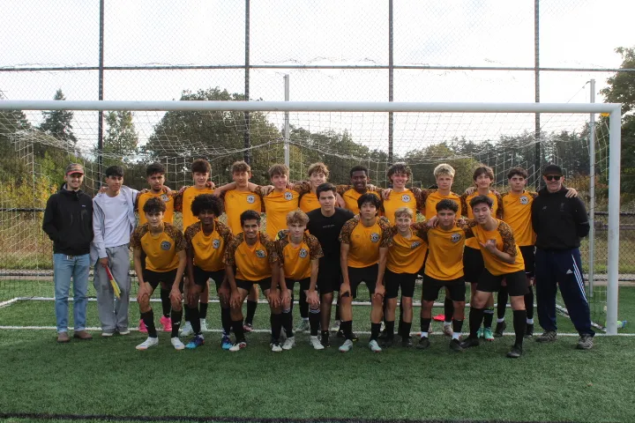
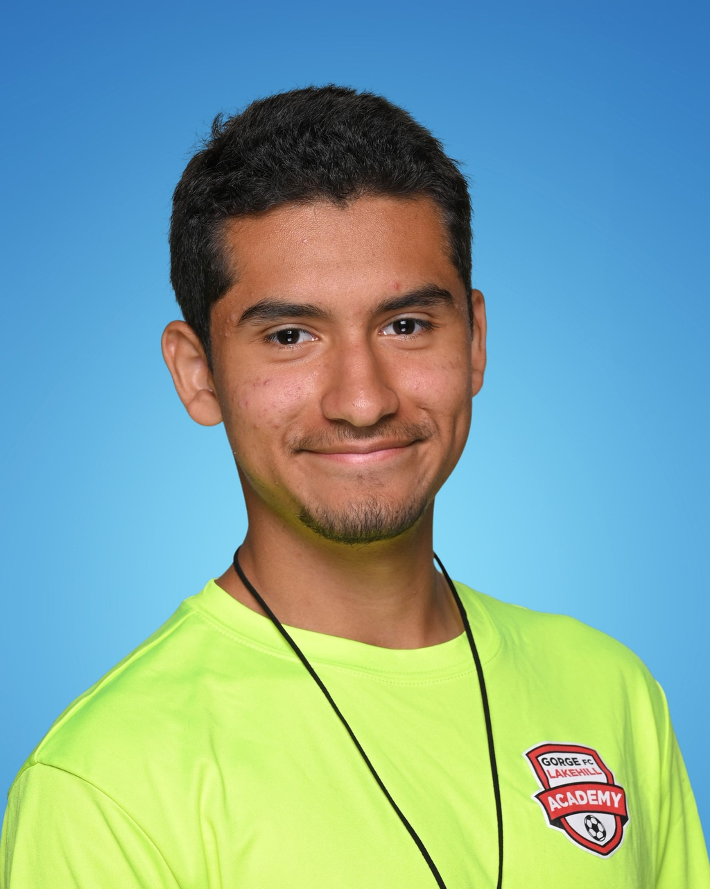
SENIOR BOYS SOCCER
TEAM MVP
ANDRES FLORES GONZALEZ

Slide 17
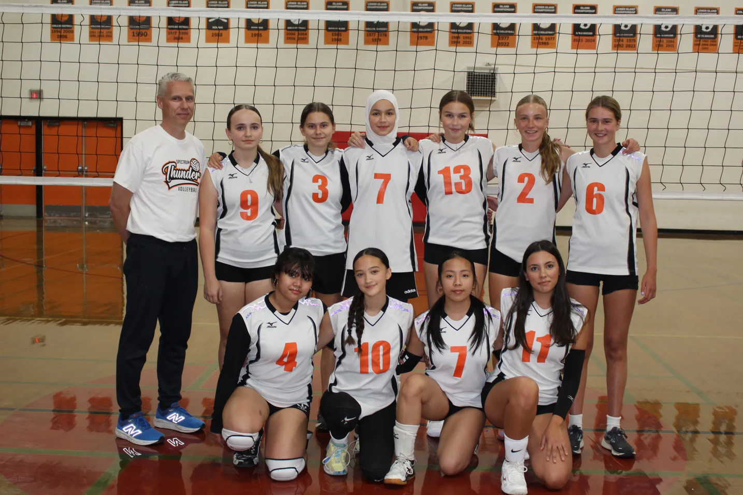
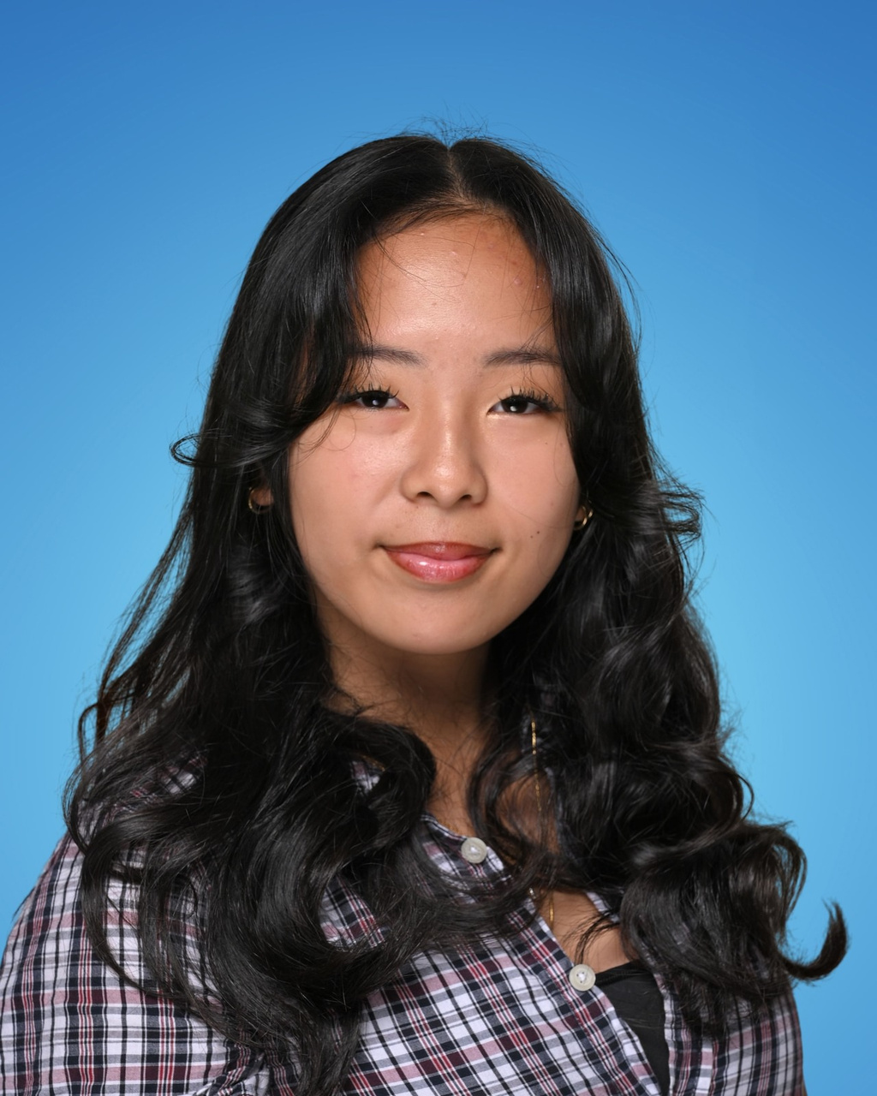
JUNIOR GIRLS VOLLEYBALL 9/10 REC
TEAM MVP -
TRIHKZIE TEJADA

Slide 18
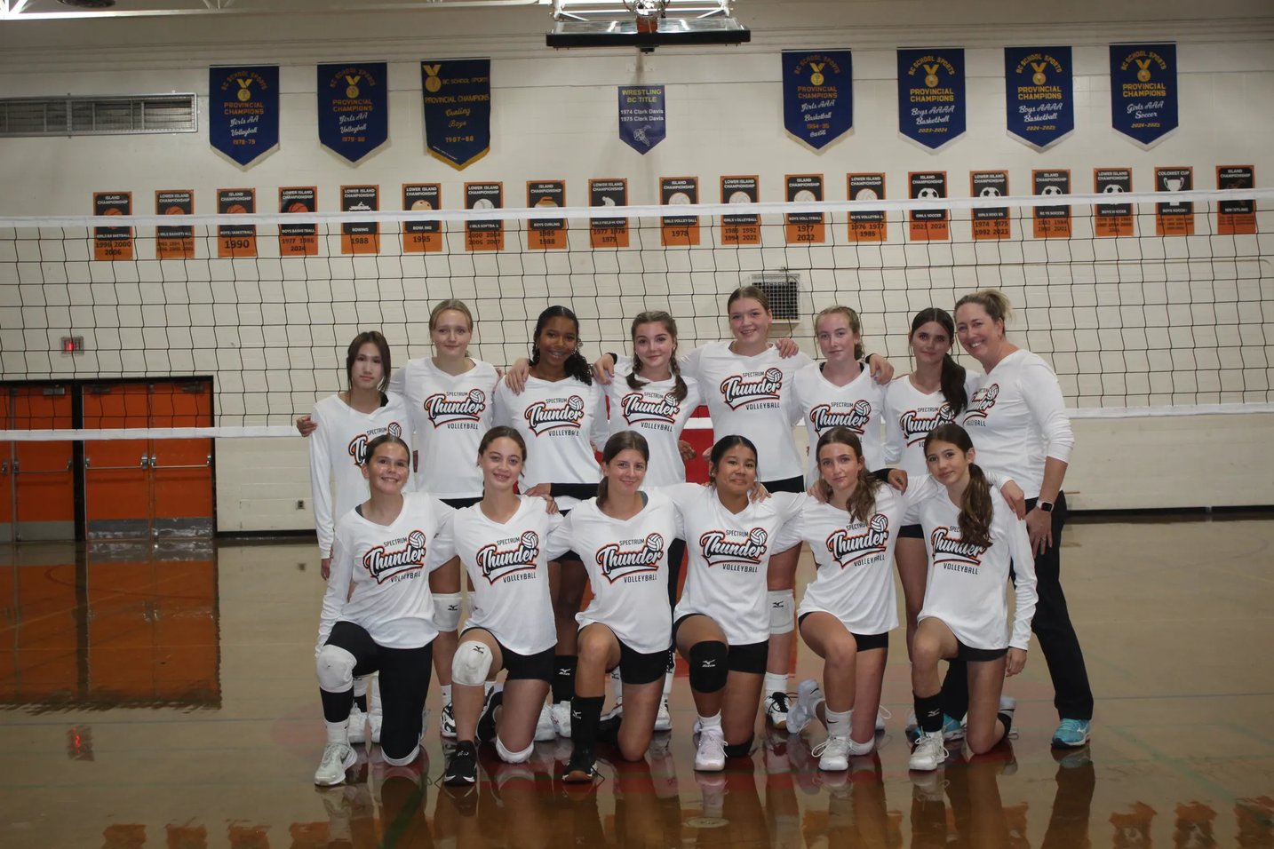
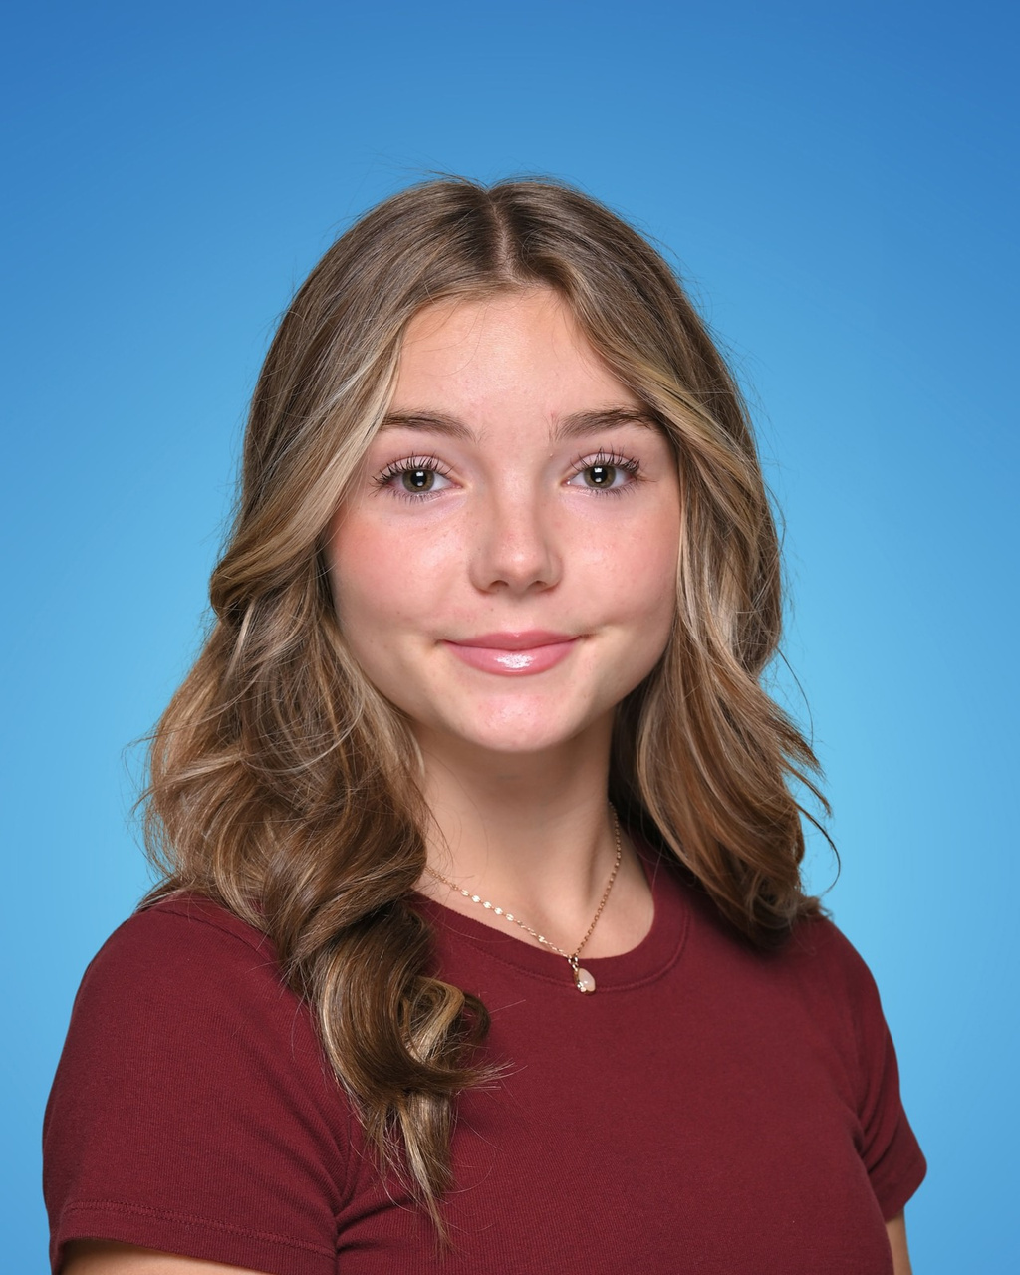
JUNIOR GIRLS VOLLEYBALL 9
TEAM MVP -
SARAH JONES

Slide 19
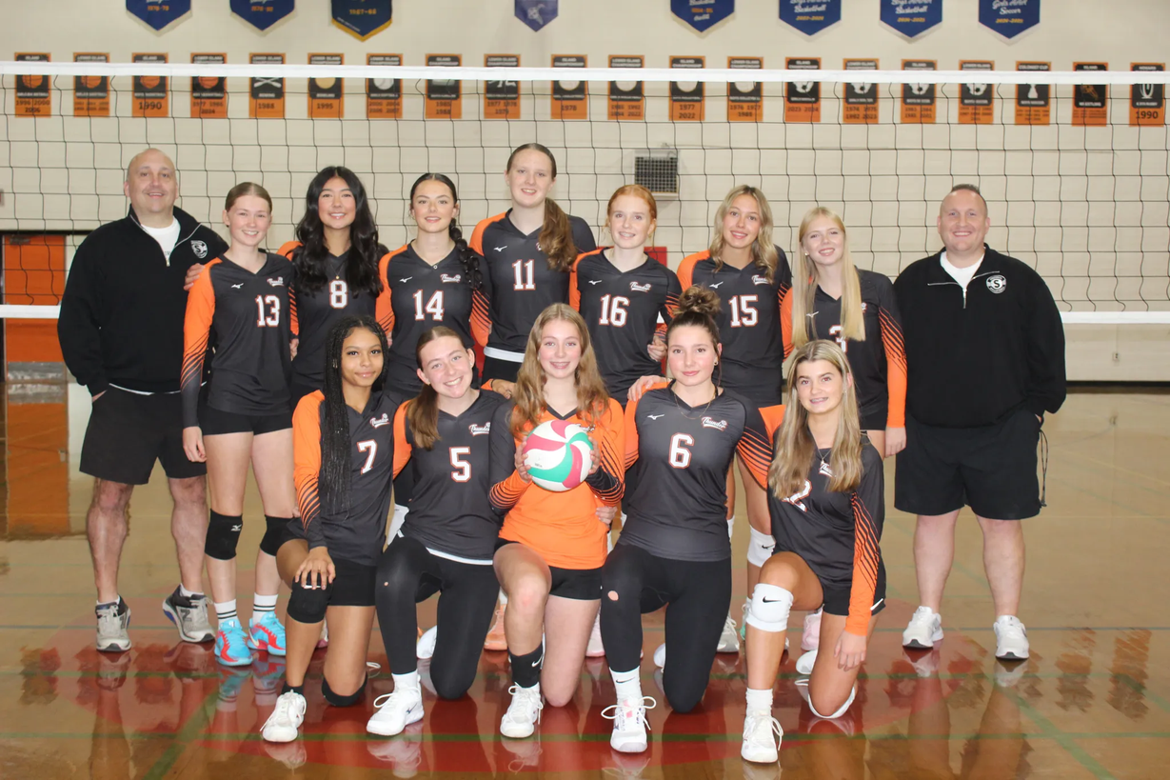
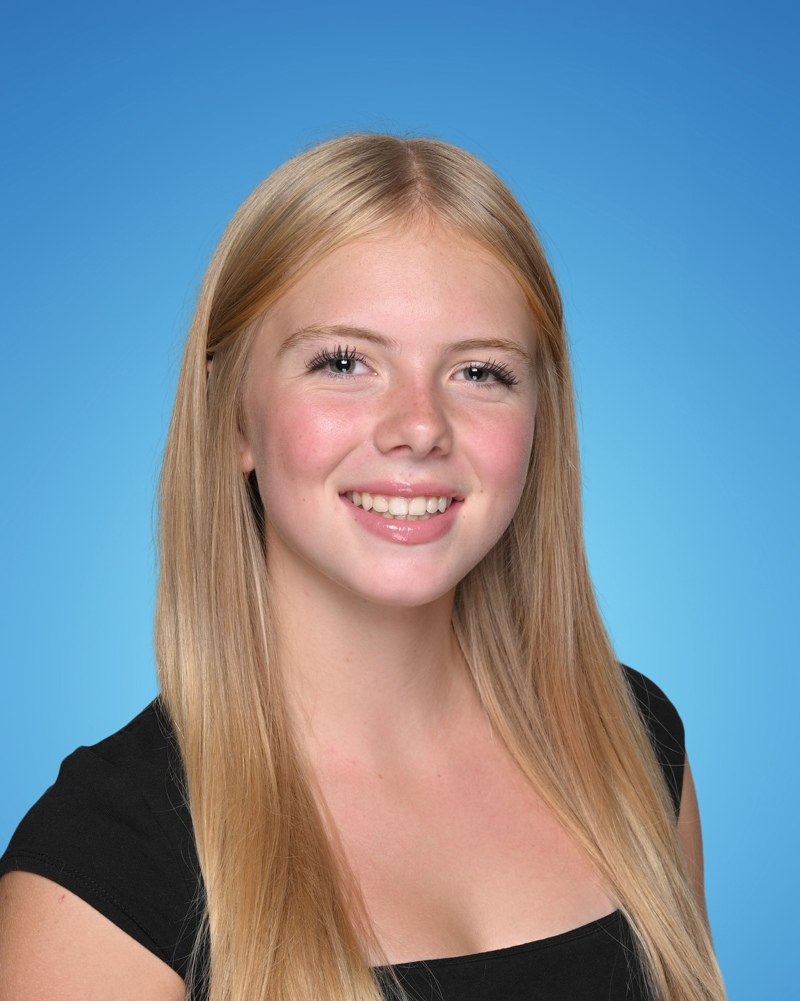
JUNIOR GIRLS VOLLEYBALL 10
TEAM MVP -
CHELSEA HINRICHSEN

Slide 20
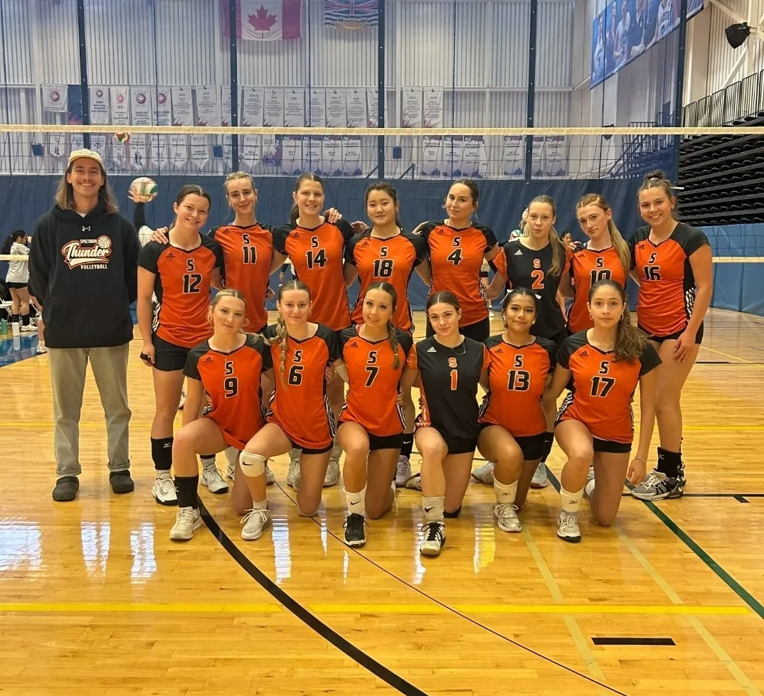
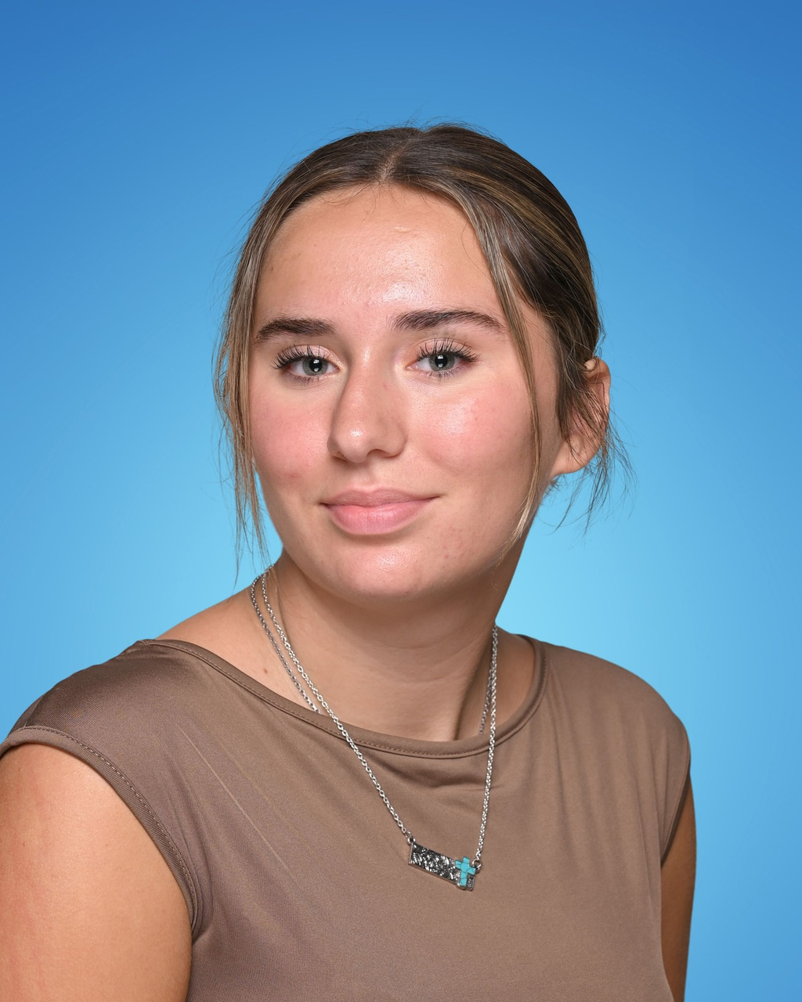
SENIOR GIRLS VOLLEYBALL
TEAM MVP -
OLIVE BUROW

Slide 21
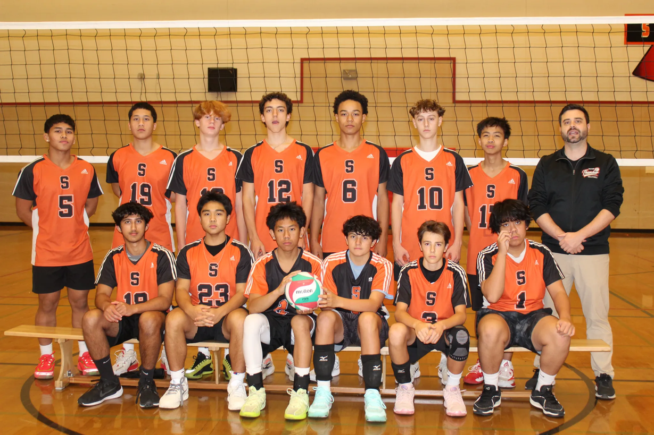
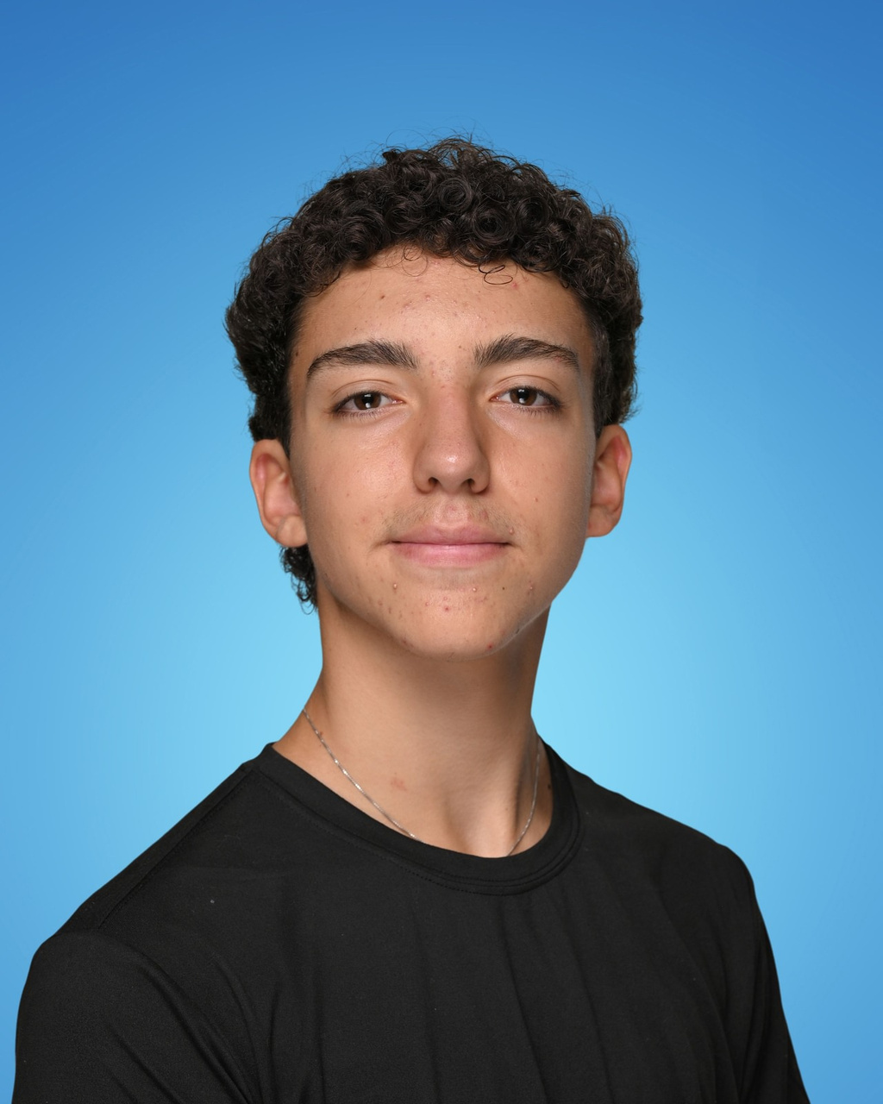
JUNIOR BOYS VOLLEYBALL
TEAM MVP -
AGUSTIN FALCO

Slide 22
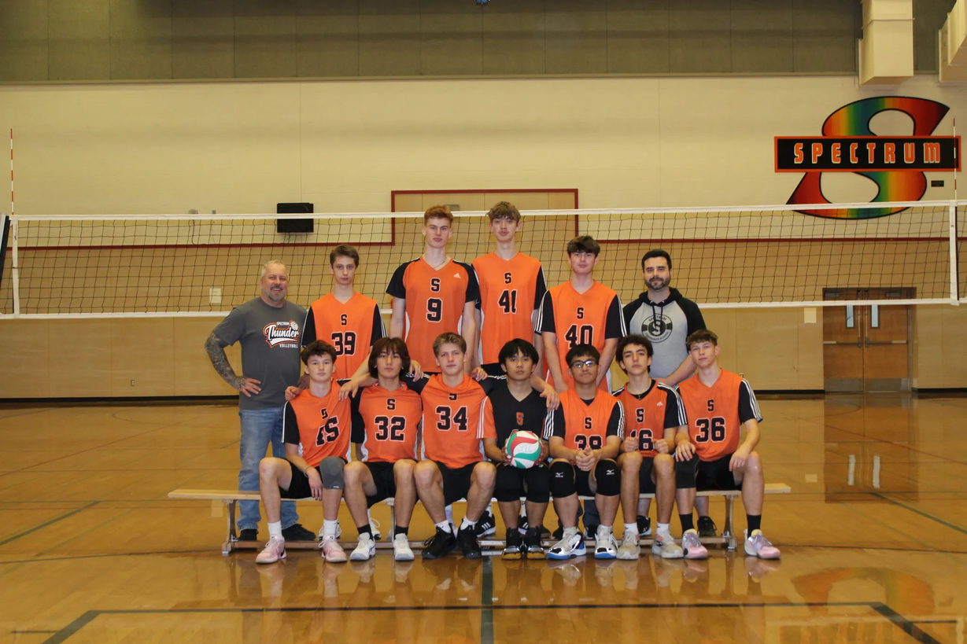
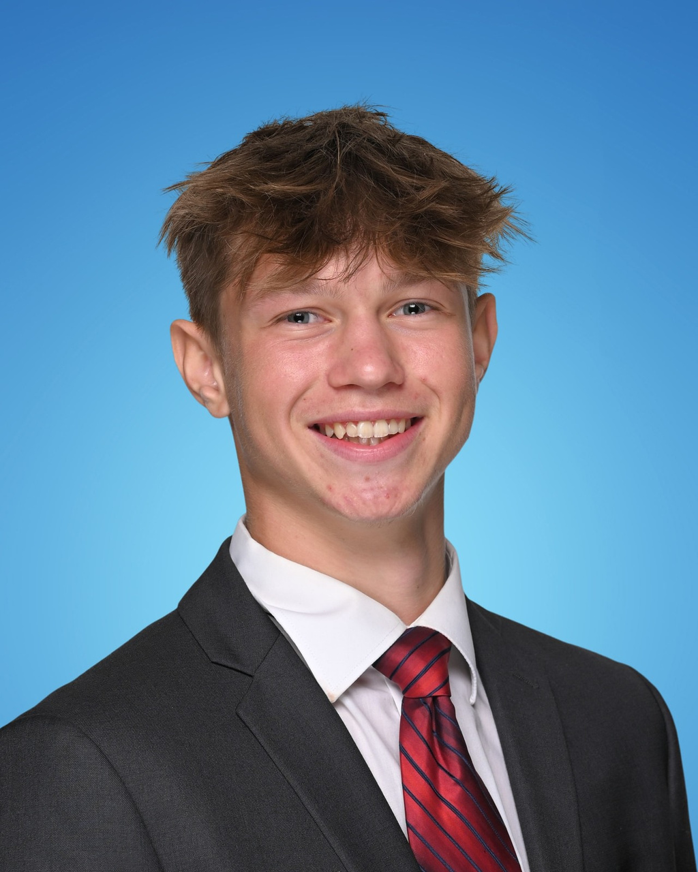
SENIOR BOYS VOLLEYBALL
TEAM MVP -
OWEN MCCULLOUGH

Slide 23
WINTER
SPORTS
JUNIOR GIRLS BASKETBALL
SENIOR GIRLS BASKETBALL
JUNIOR BOYS BASKETBALL (B)
JUNIOR BOYS BASKETBALL (A)
SENIOR BOYS BASKETBALL
WRESTLING
CURLING

Slide 24
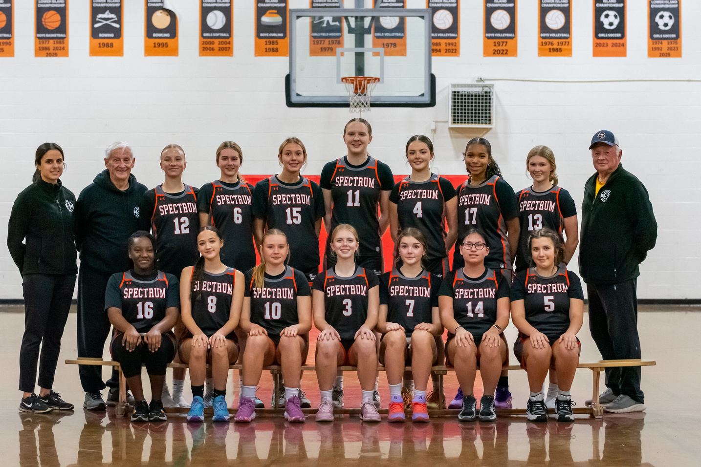
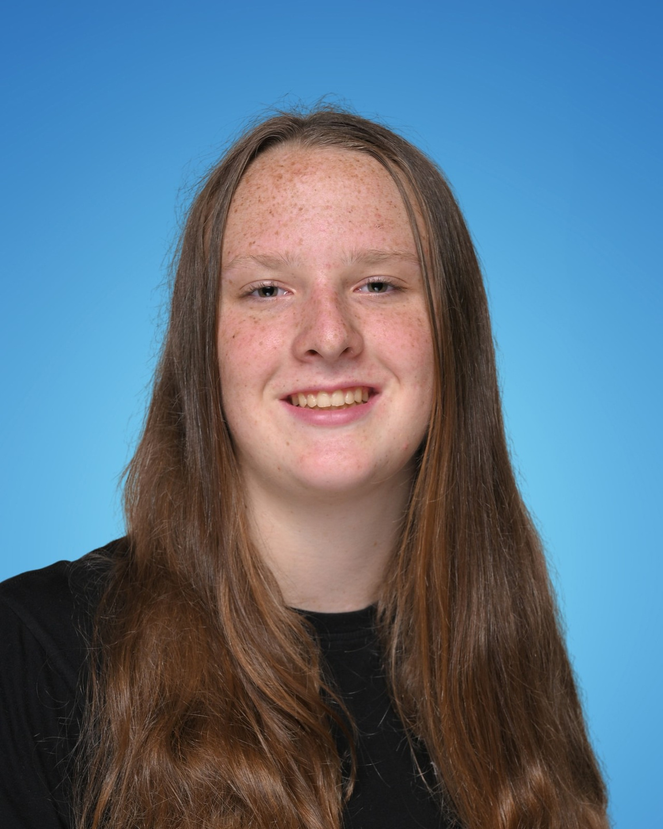
JUNIOR GIRLS BASKETBALL
TEAM MVP -
KAYLA FELT

Slide 25
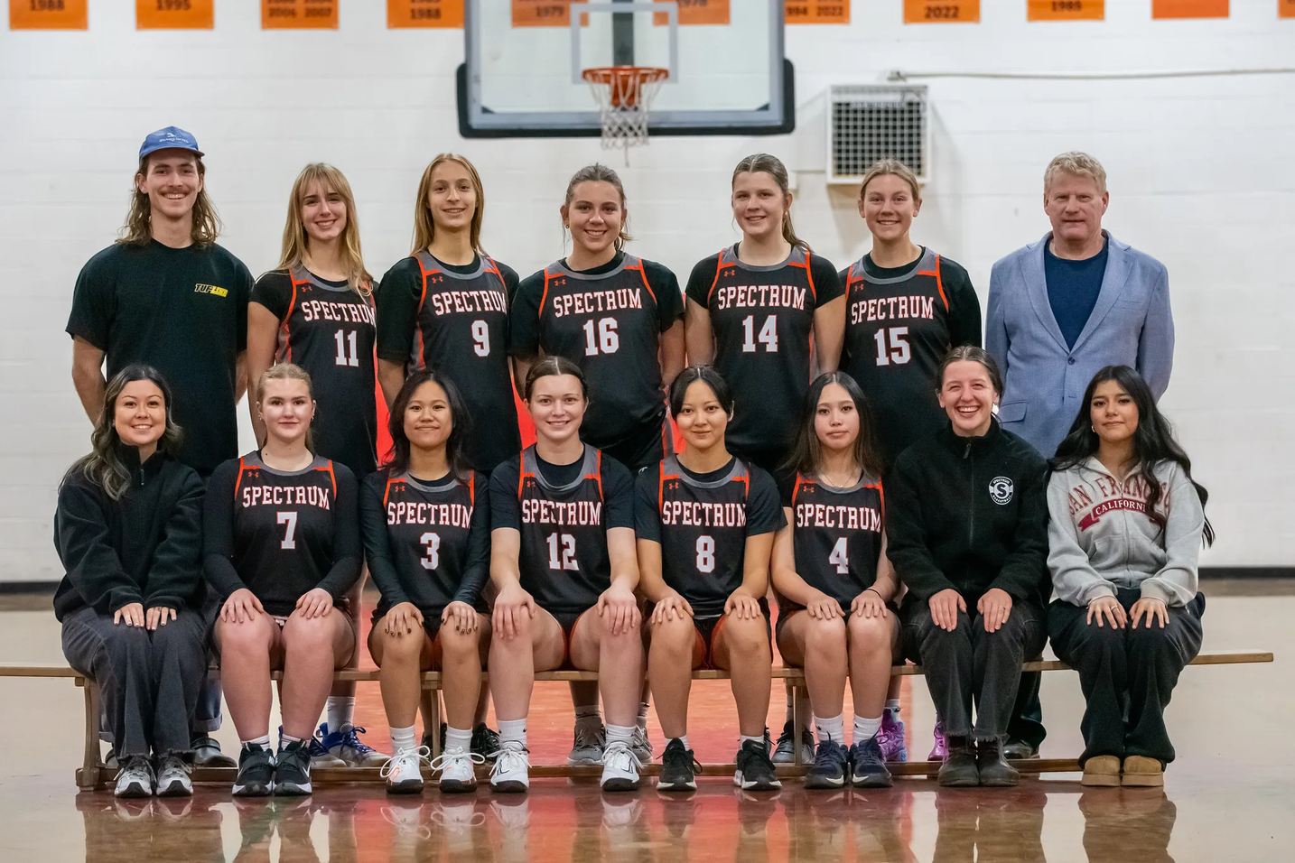
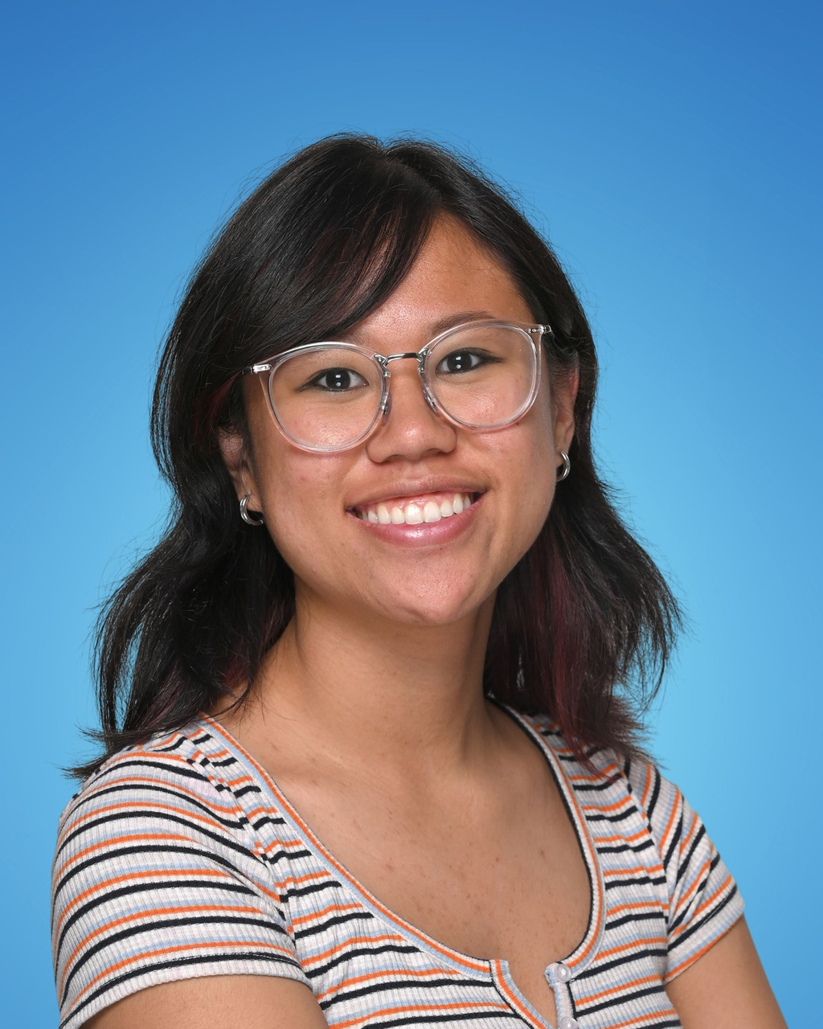
SENIOR GIRLS BASKETBALL
TEAM MVP -
ELIANA PENALOSA

Slide 26
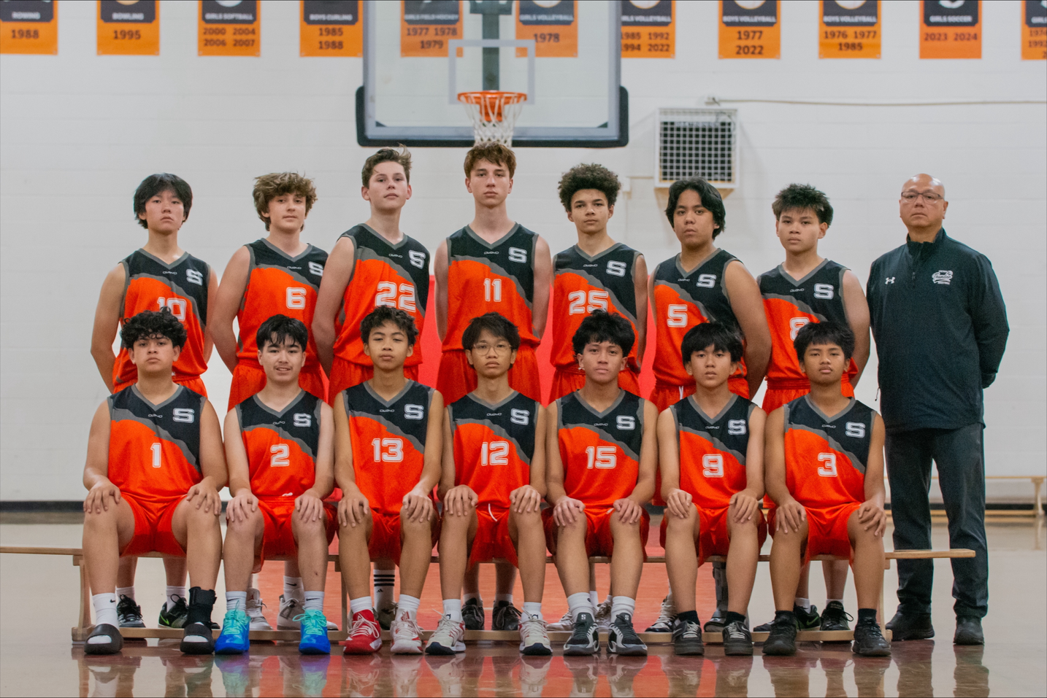
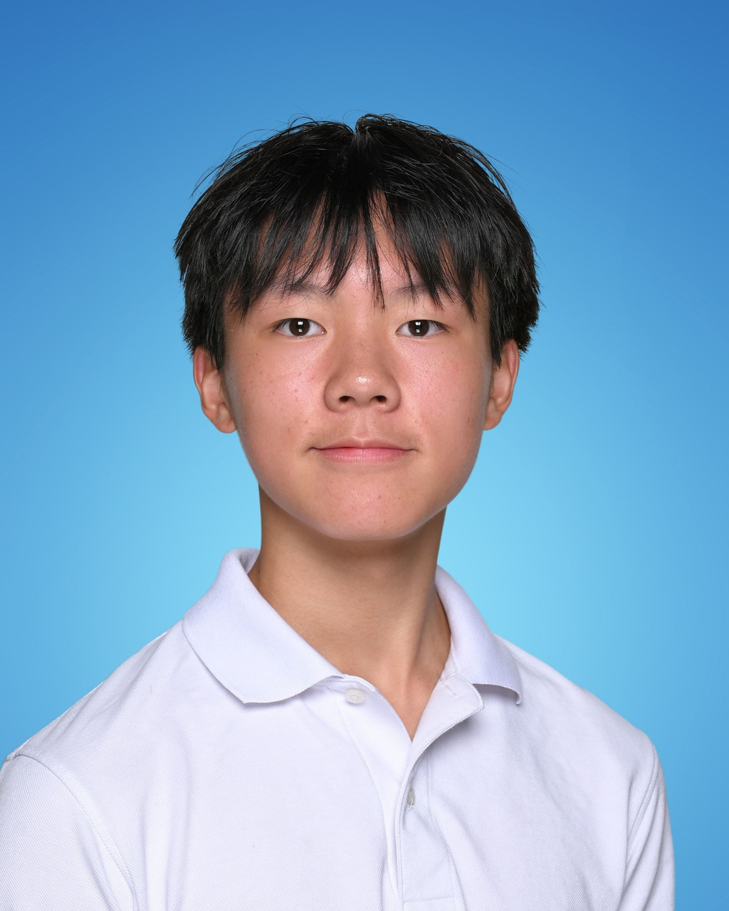
JUNIOR BOYS B BASKETBALL
TEAM MVP -
HAYDEN LAM

Slide 27
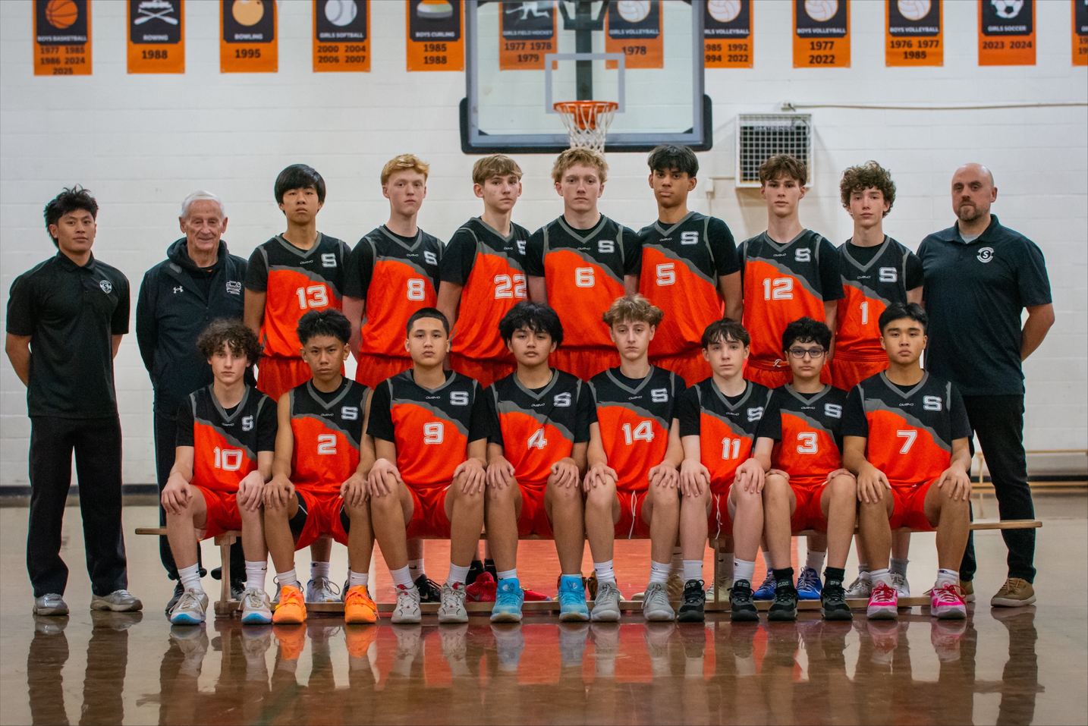
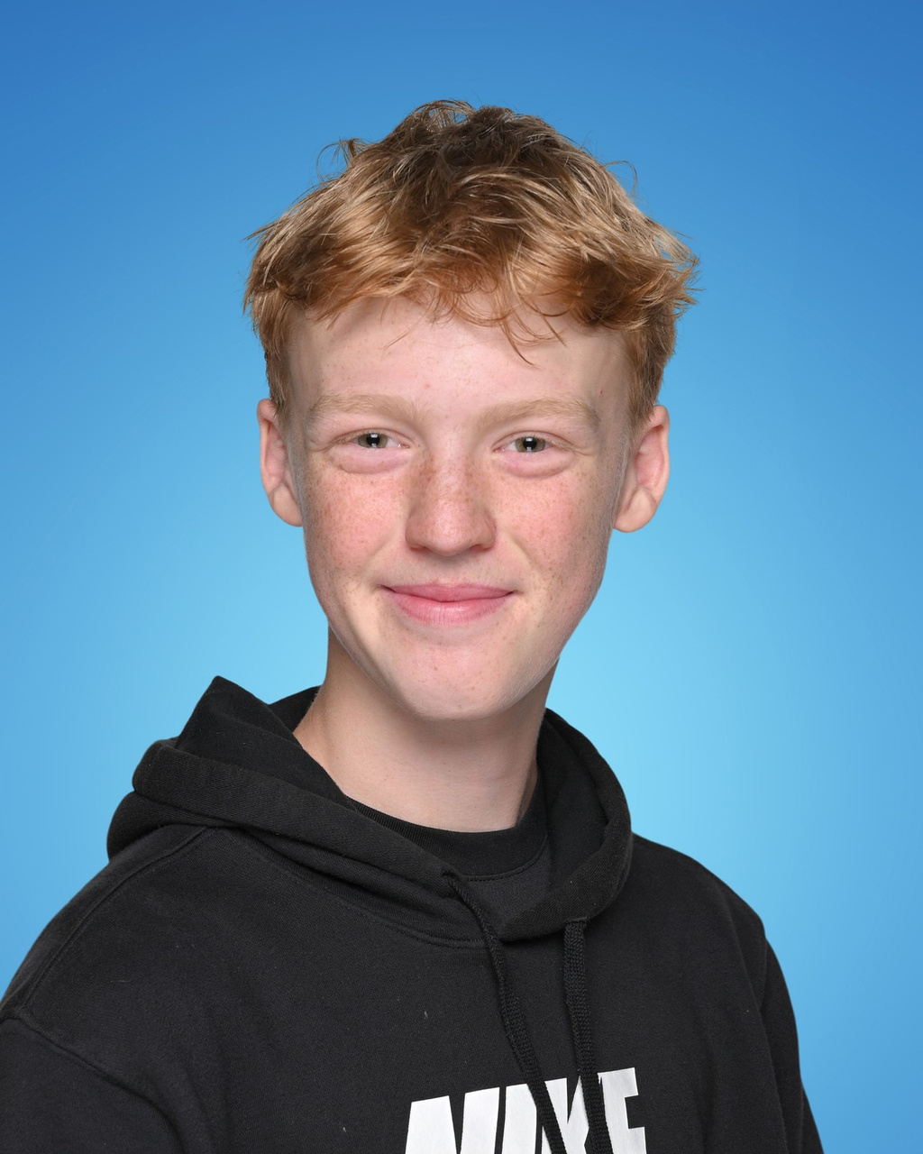
JUNIOR BOYS A BASKETBALL
TEAM MVP -
OWEN CAMPBELL

Slide 28
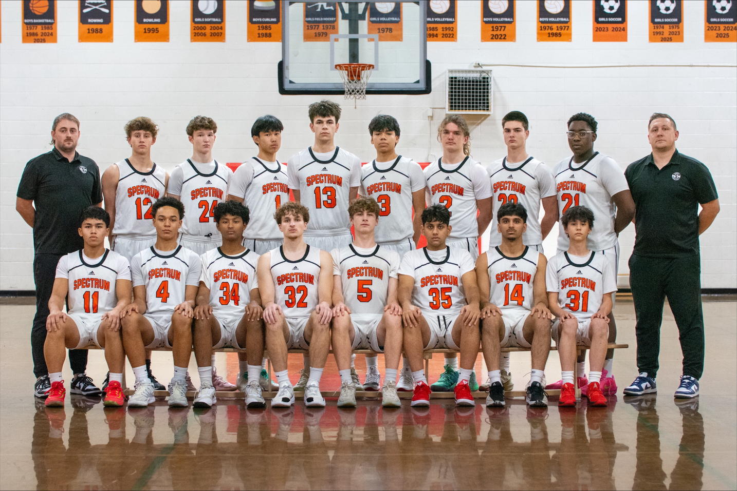
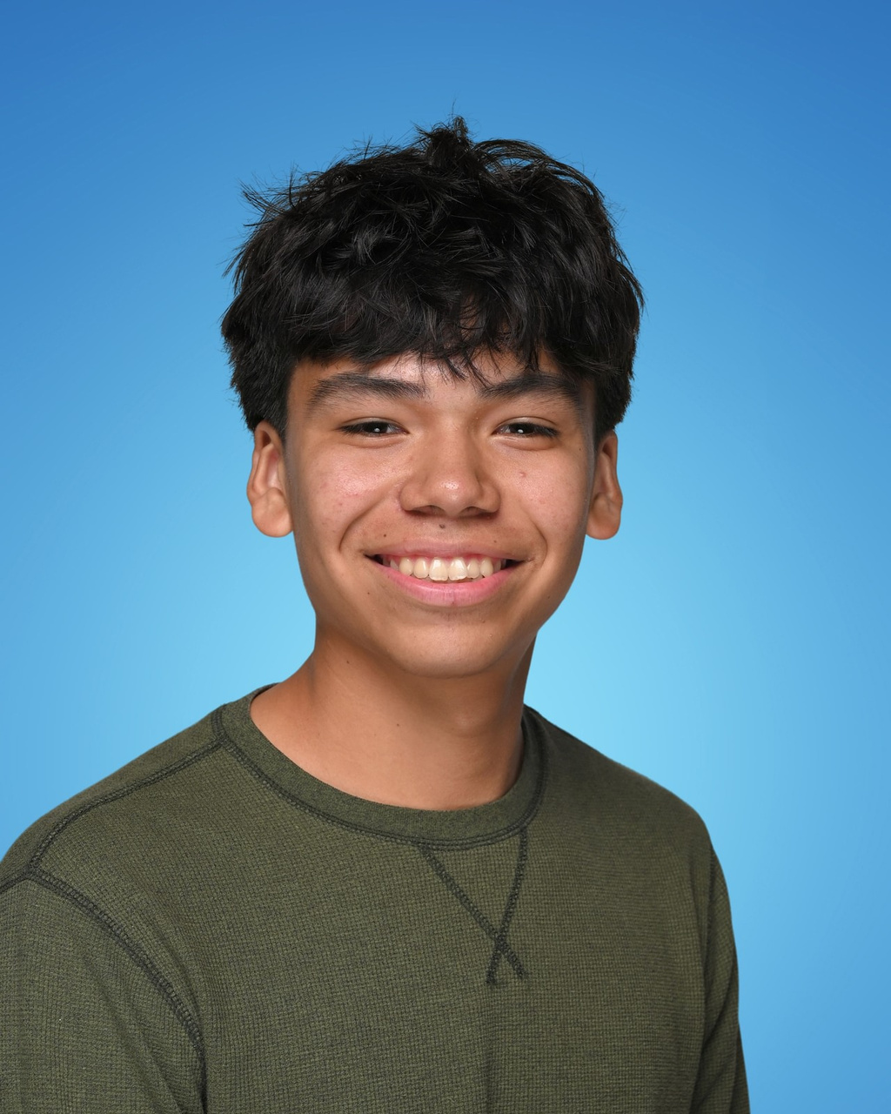
SENIOR BOYS BASKETBALL
TEAM MVP -
EVAN ENNS

Slide 29
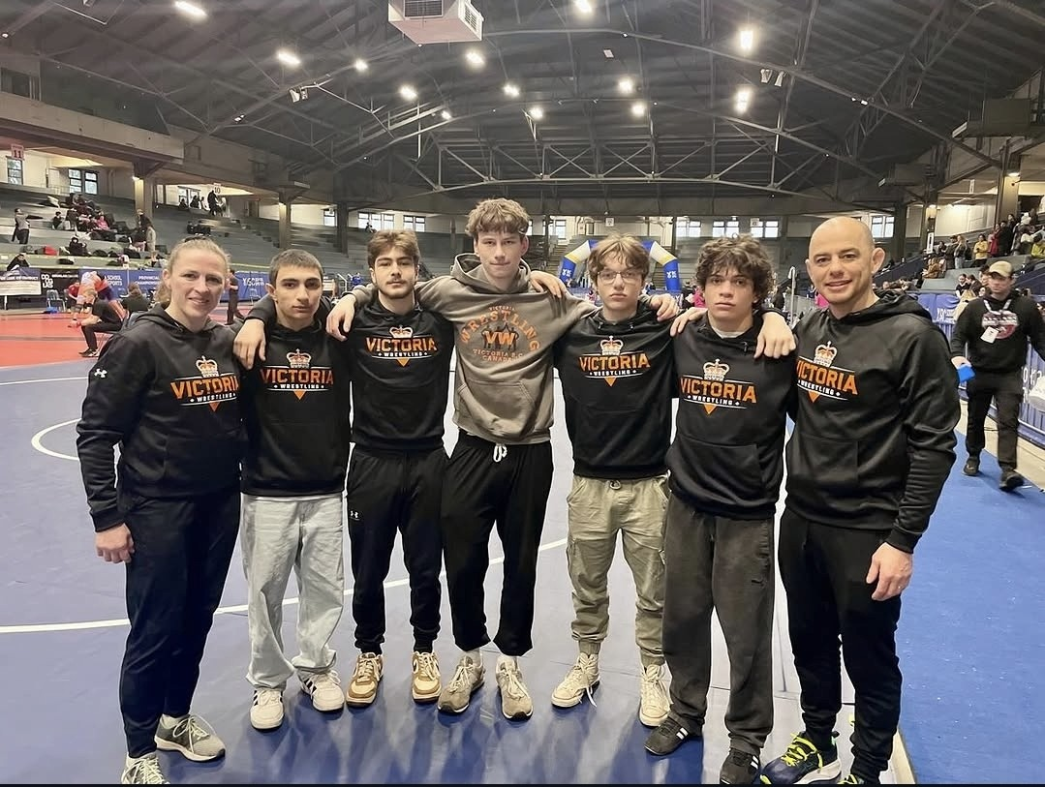

WRESTLING
TEAM MVP -
EVAN BAKER

Slide 30
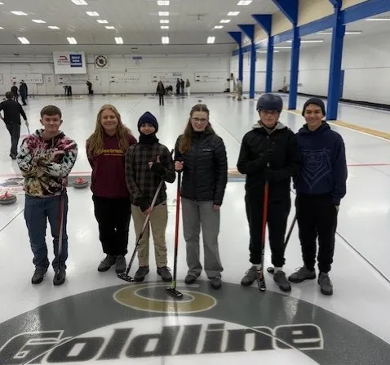
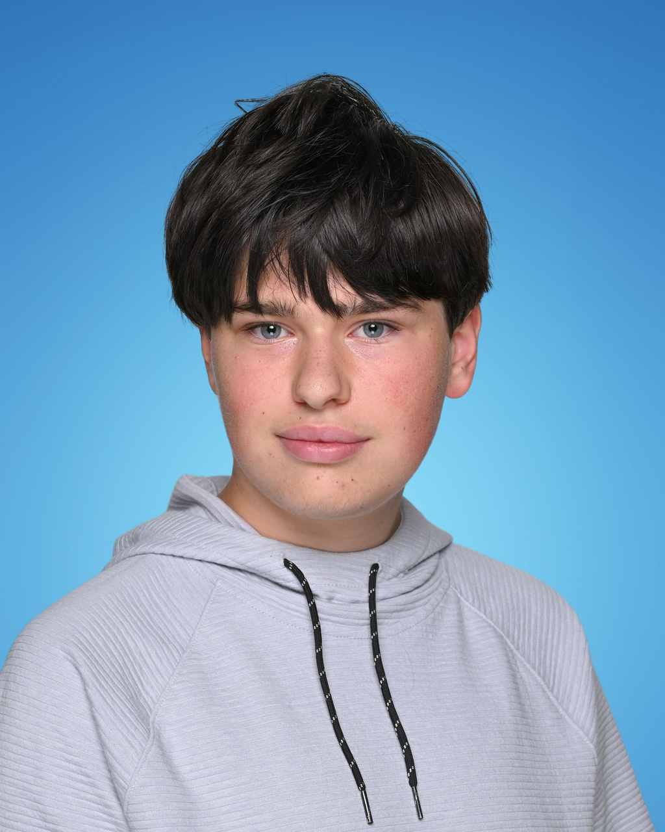
CURLING
TEAM MVP -
OLIVER LEWIS

Slide 31
SPRING
SPORTS
BADMINTON
TRACK & FIELD
GOLF
ULTIMATE FRISBEE
SENIOR GIRLS RUGBY
JUNIOR BOYS RUGBY
SENIOR BOYS RUGBY
JUNIOR GIRLS SOCCER
SENIOR GIRLS SOCCER

Slide 32
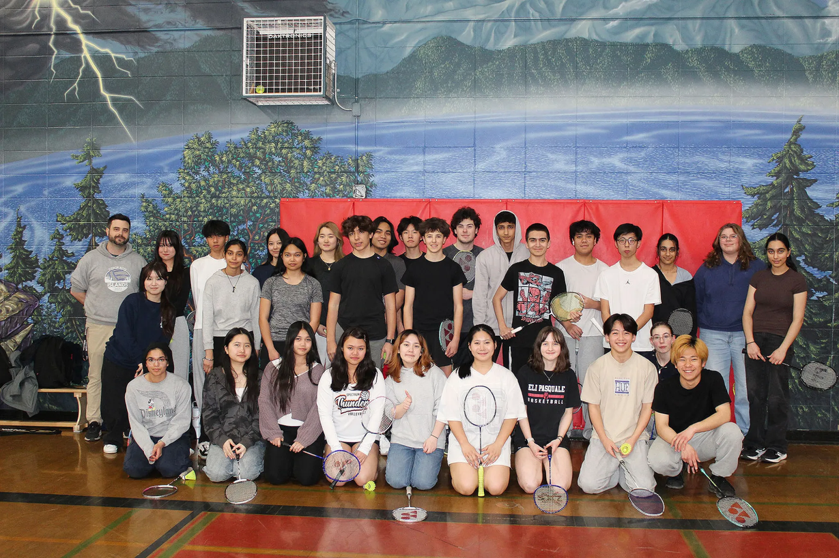
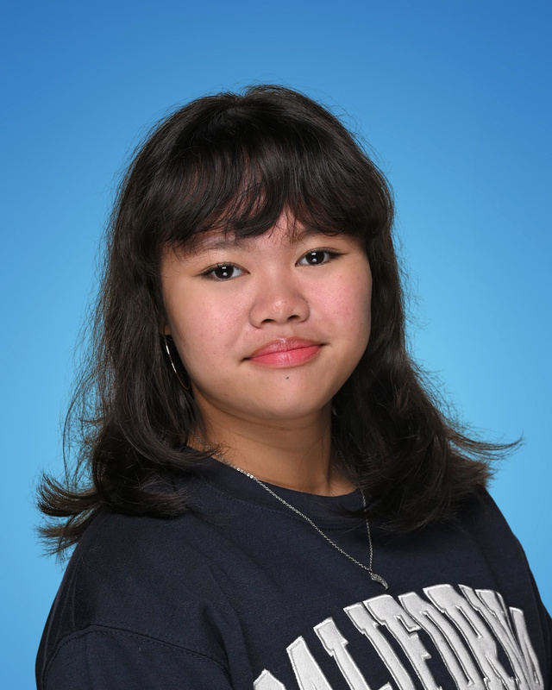

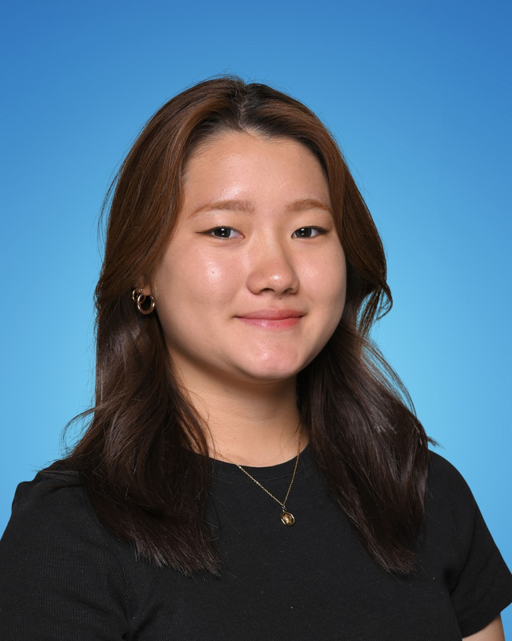
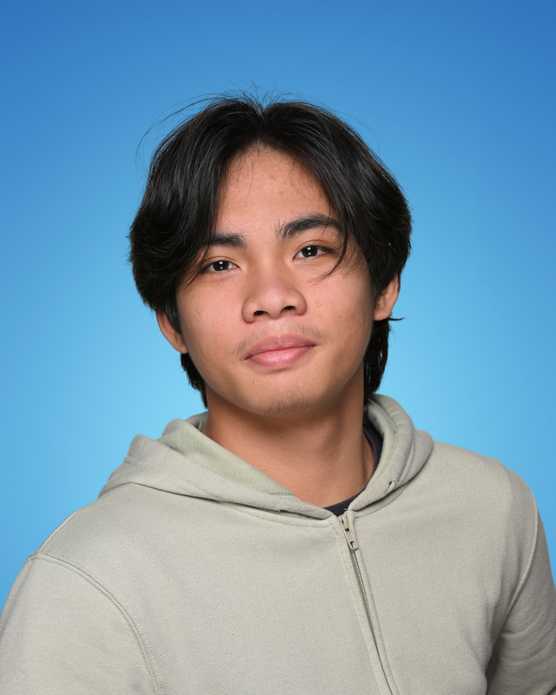
BADMINTON
JR. GIRL
JR. BOY
TEAM MVPS -
JR. ASHANTTE EATA & OWEN HEIDORN
SR. YUKA YOSHIDA & JUSTIN DEREK VALDEZ
SR. GIRL
SR. BOY

Slide 33
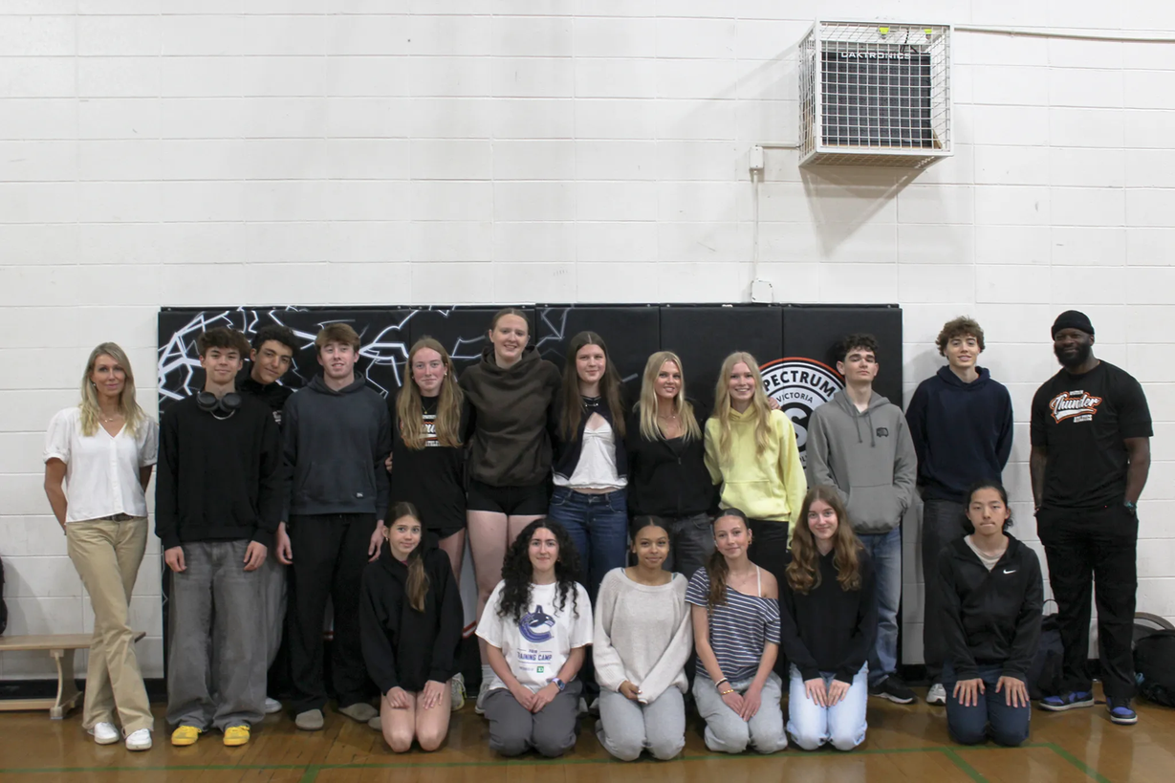
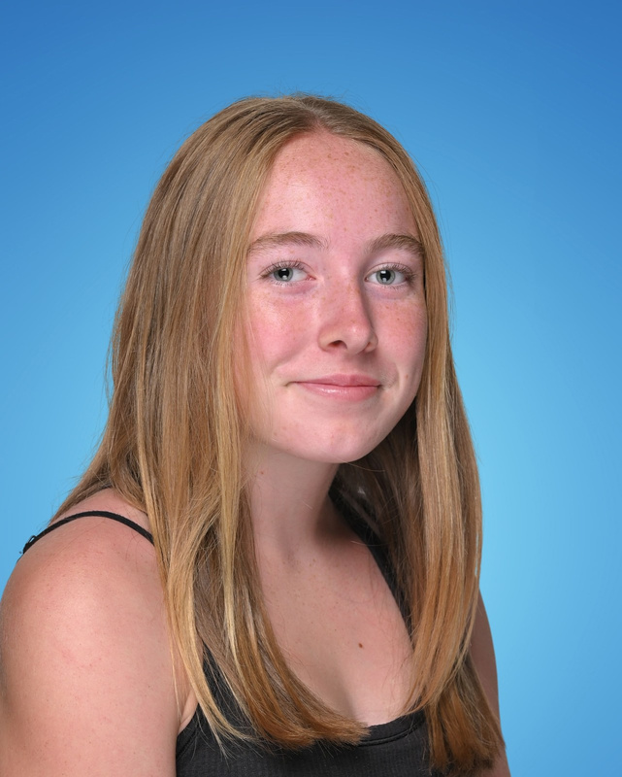
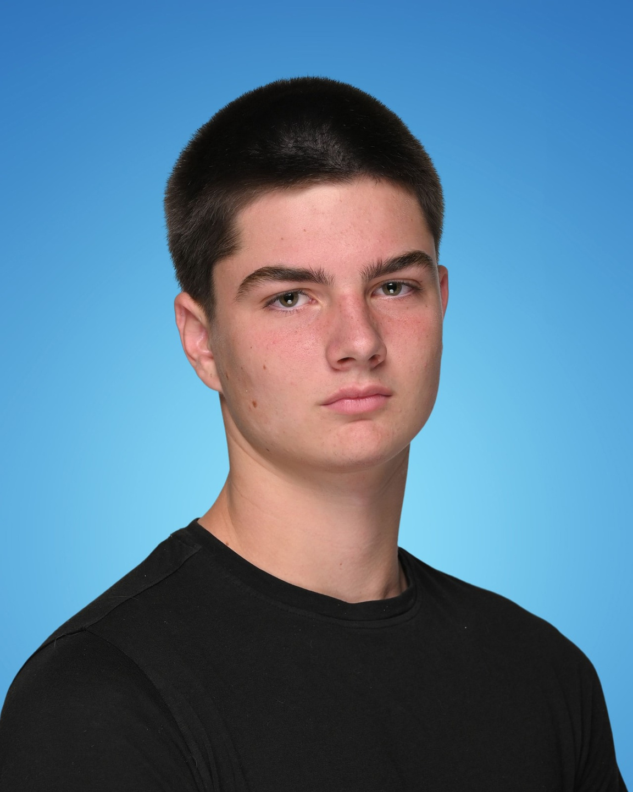
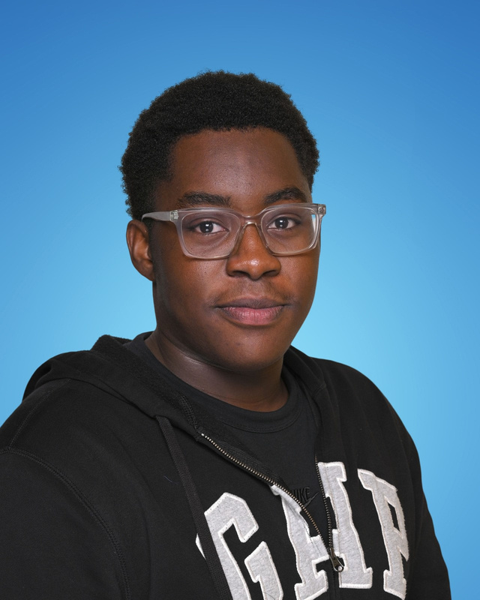
TRACK & FIELD
JR. GIRL
JR. BOY
TEAM MVPS -
JR. GRACIE WEGWITZ & LEVI SEEL
SR. ALANNA FELT & TOLUWANI ARIYO
SR. GIRL
SR. BOY

Slide 34
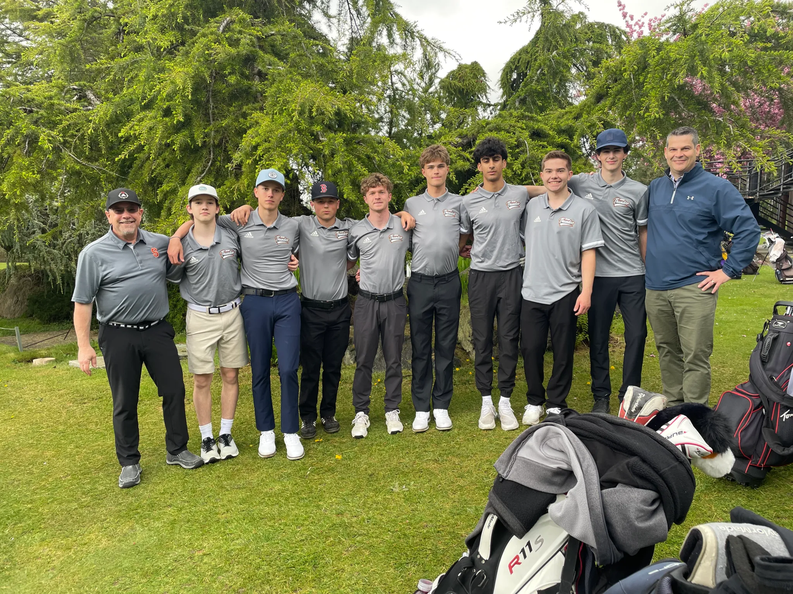

GOLF
TEAM MVP -
BRAEDEN JOHNSON

Slide 35


ULTIMATE FRISBEE
TEAM MVP -
LUCAS LAM

Slide 36


SENIOR GIRLS RUGBY
TEAM MVP -
ADA BUTCHER

Slide 37

JUNIOR BOYS RUGBY
TEAM MVP -
JACK RAMSAY

Slide 38


SENIOR BOYS RUGBY
TEAM MVP -
ADAM RIBIC

Slide 39


JUNIOR GIRLS SOCCER
TEAM MVP -
AUBRIE HARPER

Slide 40


SENIOR GIRLS SOCCER
TEAM MVP -
LAEL HARPER

Slide 41
TEAM MVP
RECAP
SR. GIRLS BASKETBALL – ELIANA PENALOSA
Sr. Boys Basketball – Evan Enns
WRESTLING – EVAN BAKER
GOLF – BRAEDEN JOHNSON
BADMINTON JR. BOYS – OWEN HEIDORN
BADMINTON JR. GIRLS – ASHANTTE EATA
BADMINTON SR. BOYS – JUSTIN DEREK VALDEZ
BADMINTON SR. GIRLS – YUKA YOSHIDA
TRACK & FIELD JR. BOYS – LEVI SEEL
TRACK & FIELD JR. GIRLS – GRACIE WEGWITZ
TRACK & FIELD SR. BOYS – TOLUWANI ARIYO
TRACK & FIELD SR. GIRLS – ALANNA FELT
JUNIOR GIRLS SOCCER – AUBRIE HARPER
SENIOR GIRLS SOCCER – LAEL HARPER
SENIOR GIRLS RUGBY – ADA BUTCHER
JUNIOR BOYS RUGBY – JACK RAMSAY
SENIOR BOYS RUGBY – ADAM RIBIC
ULTIMATE FRISBEE – LUCAS LAM
JR. GIRLS CROSS COUNTRY – RIMI TSUKIKAWA
JR. BOYS CROSS COUNTRY – COOPER ELLIOTT
SR. GIRLS CROSS COUNTRY – ALANNA FELT
SR. BOYS CROSS COUNTRY – LUCAS RUSSELL
FOOTBALL JR. VARSITY – JACK RAMSAY & AUSTIN KELLOW
FOOTBALL VARSITY – HECTOR HALL
JR. BOYS SOCCER – KESLER BOLTON
SR. BOYS SOCCER – ANDRES FLORES GONZALEZ
JR. GIRLS VOLLEYBALL 9/10 REC – TRIHKZIE TEJADA
JR. GIRLS VOLLEYBALL 9 – SARAH JONES
JR. GIRLS VOLLEYBALL 10 – CHELSEA HINRICHSEN
SR. GIRLS VOLLEYBALL – OLIVE BUROW
JR. BOYS VOLLEYBALL – AGUSTIN FALCO
SR. BOYS VOLLEYBALL – OWEN MCCULLOUGH
SWIMMING – JULIAN MILLER
CURLING – OLIVER LEWIS
JR. GIRLS BASKETBALL – KAYLA FELT
JR. BOYS B BASKETBALL – HAYDEN LAM
JR. BOYS A BASKETBALL – OWEN CAMPBELL

Slide 42
MAJOR
ATHLETIC AWARDS

Slide 43
KEEPING GIRLS IN SPORT LEADERSHIP AWARD
CHELSEA
HINRICHSEN
Keep Girls in Sports (KGiS) is a Victoria based community group focused on providing opportunities to young female athletes. By age 14, girls are dropping out of sports at twice the rate of boys. Furthermore, 25% fewer girls are coming back to sport after the pandemic. This has lifelong implications for young women. Participating in sports bolsters confidence, improves communication skills, and fosters the ability to work with others for common goals. One of the ways KGiS attempts to address this issue is by sponsoring a series of awards to be given out annually in all South Island Secondary Schools. The recipient will be a junior girl who demonstrates the following leadership qualities:
• HARDWORKING: SHE WORKS HARD IN TRAINING, PRACTICES, AND IN
GAMES. WILLING TO LEND A HAND TO COACHES AND VOLUNTEERS.
• COMMITTED: SHE CAN BE RELIED ON TO SHOW UP TO EVERY
PRACTICE AND GAME, AND GIVE HER BEST EFFORT
• COMMUNICATIVE: SHE MAKES AN EFFORT TO TALK TO
TEAMMATES, COACHES, AND REFEREES
• SUPPORTIVE: SHE LISTENS TO HER TEAMMATES AND IS READY
TO HELP THEM DO THEIR BEST
• SPORTSMANSHIP: SHE FOLLOWS THE RULES AND BEHAVES IN AN
ETHICAL MANNER. SHE CELEBRATES GREAT PLAYS BY BOTH TEAMS
• POSITIVE ATTITUDE: WHEN PROBLEMS ARISE, SHE LOOKS
FOR SOLUTIONS AND STAYS POSITIVE
Notes:
The next award is for leadership in sport. This award comes from the Keep Girls in Sports organization. KGiS is a Victoria based community group dedicated to providing opportunities for young female athletes in South Island. Stats show that by age 14, girls are dropping out of sports at twice the rate of boys. This has lifelong implications for young women.
As you know, sport bolsters confidence, improves communication skills and fosters the ability to work with others.
The KGiS leadership award goes to the young female athlete who exemplifies hard work, commitment, integrity and is positive and supportive with her coaches and teammates.
As part of this award the recipient will receive this trophy, gift card and KGiS t-shirt.
This year’s KGIS Leadership Award goes to Chelsea Hinrichsen.

Slide 44
ROOKIE OF THE
YEAR AWARD
This award is presented to a female and male Grade 9 or 10 student-athlete who has made an outstanding impact in their first two years of high school athletics. This athlete has demonstrated exceptional talent, dedication, and sportsmanship while competing on at least two sports teams. As a true ambassador of Spectrum Thunder Athletics, they embody teamwork, perseverance, and a positive attitude both on and off the field of play. Their commitment and passion for sports set a strong foundation for future success within the program.

Slide 45



NOMINATIONS - FEMALE ROOKIE OF THE YEAR AWARD
GRACIE
WEGWITZ
PEYTON
MCLEAN
MARIKA
MARTENS
KAYLA
FELT
SARAH
JONES
ISLA
BUTCHER

Slide 46






NOMINATIONS - MALE ROOKIE OF THE YEAR AWARD
AGUSTIN
FALCO
ROAN
LANGLOIS
MAX
EDWARDS
NICK
MARSH
BRODY
GALEGO
SETH
BURGOS
ARYAN
VASHISHTA

Slide 47
ROOKIES
OF THE YEAR AWARD
KAYLA
FELT
SETH
BURGOS

Slide 48
OUTSTANDING CITIZENSHIP & SERVICES TO ATHLETICS
This award is presented to a student-athlete who has made an extraordinary impact on the athletic department through exceptional service, leadership, and dedication beyond their required commitments. The recipient has gone above and beyond in contributing to the success of the school’s athletics program, demonstrating a strong commitment to mentorship, team development, and the overall improvement of athletics. Through their dedication, initiative, and willingness to support and train fellow student-athletes, they have set a standard of excellence and leadership that inspires others both on and off the field of play.

Slide 49





NOMINATIONS - OUTSTANDING CITIZENSHIP & SERVICES TO ATHLETICS
ARMAAN
DHADE
SAWYER
CHALUPNIK
STELLA
SLAMET
LIZ
ALLAN
ELIANA
PENALOSA
ALANNA
FELT
BRIANNA
COMENDADOR

Slide 50
OUTSTANDING CITIZENSHIP &
SERVICES TO ATHLETICS
AWARD
BRIANNA COMENDADOR

Slide 51
MOST DEDICATED STUDENT-ATHLETE AWARD
ALANNA
FELT
This prestigious award is presented to a student-athlete who has demonstrated academic achievement through consistent dedication and perseverance while competing in at least two seasons of athletics. The recipient exemplifies the balance of academic excellence and athletic commitment, maintaining strong academic standards while making significant contributions to their teams. This award recognizes the dedication, discipline, and perseverance required to excel both in the classroom and in competition.
Notes:
The next award is for leadership in sport. This award comes from the Keep Girls in Sports organization. KGiS is a Victoria based community group dedicated to providing opportunities for young female athletes in South Island. Stats show that by age 14, girls are dropping out of sports at twice the rate of boys. This has lifelong implications for young women.
As you know, sport bolsters confidence, improves communication skills and fosters the ability to work with others.
The KGiS leadership award goes to the young female athlete who exemplifies hard work, commitment, integrity and is positive and supportive with her coaches and teammates.
As part of this award the recipient will receive this trophy, gift card and KGiS t-shirt.
This year’s KGIS Leadership Award goes to Chelsea Hinrichsen.

Slide 52
TEAM OF THE YEAR AWARD
This award is presented to the team that has demonstrated outstanding achievement, dedication, and sportsmanship throughout the season. This team has shown excellence in competition, unwavering commitment to their sport, and a strong sense of teamwork and unity. Their perseverance, discipline, and respect for the game have made them exemplary ambassadors of Spectrum Thunder Athletics. Through their collective effort, they have set a high standard for success and left a lasting impact on the athletic program.

Slide 53





TEAM OF THE YEAR AWARD
2025-2026
JUNIOR GIRLS VOLLEYBALL 10
REGULAR SEASON LEAGUE [23-5-0] 2ND PLACE
CAMOSUN COLLEGE CHAMPIONS
SPECTRUM SPIKES & ACES CHAMPIONS
OAK BAY BUMPKIN PUMPKIN CHAMPIONS
CITY CHAMPIONSHIPS 2ND PLACE
VANCOUVER ISLAND CHAMPIONSHIPS - CHAMPIONS

Slide 54
FAIRPLAY & LEADERSHIP AWARD
This award recognizes an athlete who embodies the core values of sportsmanship, respect, and integrity within Spectrum Thunder Athletics. The recipient demonstrates fairness, teamwork, and a positive attitude, both in competition and in representing the spirit of the program. Through their actions, they inspire teammates and uphold the highest standards of athletic excellence and character.

Slide 55
FAIRPLAY & LEADERSHIP AWARD
JUNIOR FEMALE & MALE NOMINATIONS

Slide 56



NOMINATIONS - FAIRPLAY & LEADERSHIP AWARD (JR. FEMALE)
LUCY
MARI
KALLI SIMPSON
KAYLA FELT
CHELSEA HINRICHSEN
AMIRA
DAVIES
GRACIE WEGWITZ

Slide 57


NOMINATIONS - FAIRPLAY & LEADERSHIP AWARD (JR. MALE)
SAWYER
CHALUPNIK
AUSTIN
KELLOW
ELISON
PENALOSA
AGUSTIN FALCO
HAYDEN
LAM
JACK
RAMSAY
LUCAS
LAM

Slide 58
JUNIOR
FAIRPLAY & LEADERSHIP
AMIRA
DAVIES
SAWYER
CHALUPNIK

Slide 59
FAIRPLAY & LEADERSHIP AWARD
SENIOR FEMALE & MALE NOMINATIONS

Slide 60



NOMINATIONS - FAIRPLAY & LEADERSHIP AWARD (SR. FEMALE)
OLIVE
BUROW
ALANNA
FELT
LIZ
ALLAN
LAEL HARPER
ELIANA PENALOSA
NEKA
RIECKEN
NORAH
SMITH
CALLIE
TURPIN

Slide 61




NOMINATIONS - FAIRPLAY & LEADERSHIP AWARD (SR. MALE)
ROCKY
SAGGI
ADAM
RIBIC
EVAN
ENNS
JACK
SHAW
MATT
FREY
KIAN
PAY

Slide 62
SENIOR
FAIRPLAY & LEADERSHIP
LIZ
ALLAN
ADAM
RIBIC

Slide 63
ATHLETE OF THE YEAR
This award is presented to the most outstanding student-athlete who has demonstrated exceptional skill, dedication, and sportsmanship throughout the season. This athlete has consistently excelled in competition, shown unwavering commitment to their team, and embodied the core values of Spectrum Thunder Athletics all while being a student in good standing. Through hard work, perseverance, and leadership, the recipient has set a standard of excellence, inspiring teammates and leaving a lasting impact on the athletic program.

Slide 64
ATHLETE OF THE YEAR
JUNIOR FEMALE & MALE NOMINATIONS

Slide 65

NOMINATIONS - TOP JR. FEMALE ATHLETE OF THE YEAR
AUBRIE
HARPER
LINNAEA
FRANKE
KALLI SIMPSON
KAYLA FELT
CHELSEA HINRICHSEN
AMIRA
DAVIES
GRACIE WEGWITZ

Slide 66


NOMINATIONS - TOP JR. MALE ATHLETE OF THE YEAR
BLAKE
ALBISO
JACK RAMSAY
SETH BURGOS
AGUSTIN FALCO
BENJI
WEGWITZ
SAWYER
CHALUPNIK
LEVI
SEEL
LUCAS
LAM

Slide 67
JUNIOR
ATHLETES OF THE YEAR
KALLI
SIMPSON
LEVI
SEEL

Slide 68
ATHLETE OF THE YEAR
SENIOR FEMALE & MALE NOMINATIONS

Slide 69


NOMINATIONS - TOP SR. FEMALE ATHLETE OF THE YEAR
CALLIE
TURPIN
ALANNA
FELT
LAEL HARPER
NEKA
RIECKEN
LIZ
ALLAN
SARAH
TENE
SIERRA
HLIVA

Slide 70

NOMINATIONS - TOP SR. MALE ATHLETE OF THE YEAR
OWEN
MCCULLOUGH
NOAH FRANKE
EVAN ENNS
HECTOR
HALL
ANDRES
FLORES GONZALEZ
ADAM
RIBIC
JULIAN MILLER

Slide 71
SENIOR
ATHLETES OF THE YEAR
CALLIE
TURPIN
LAEL
HARPER
EVAN
ENNS
JULIAN
MILLER

Slide 72
THANK YOU
FOR COMING!
PIZZA & BEVERAGES ARE WAITING ACROSS THE HALL IN THE CAFETERIA, PLEASE MOVE THERE IN A RESPECTFUL MANNER. THERE IS 2 PIECES OF PIZZA AND A DRINK PER ATHLETE.
FEEL FREE TO STICK AROUND & SOCIALIZE!
Notes:
Call for those with food allergies or preferences to go first.
Gluten Free
Celiac
Nut Allergy
Religious reasons

